Slide 1
Chapter 1
An introduction to relational databases

Slide 2
Objectives
Identify the three main hardware components of a client/server system.
Describe the way a client accesses the database on a server using these terms: application software, data access API, database management system, SQL query, and query results.
Describe the way a relational database is organized using these terms: tables, columns, rows, cells, primary keys, unique keys, and foreign keys.
Identify the three types of relationships that can exist between two tables.
Describe the way the columns in a table are defined using these terms: data type, null value, and default value.

Slide 3
Objectives (continued)
Describe how an entity relationship diagram can show how the tables in a database are defined and related.
Describe the difference between DML statements and DDL statements.
List three coding techniques that can make your SQL code easier to read and maintain.
Describe the use of a database driver.

Slide 4
What is Database?
Collection of Data
Wikipedia: An organized collection of data stored and accessed electronically from a computer system.
Database
App
DBMS
Database
MySQL
PostgresSQL
SQL Server
Oracle Database

Slide 5
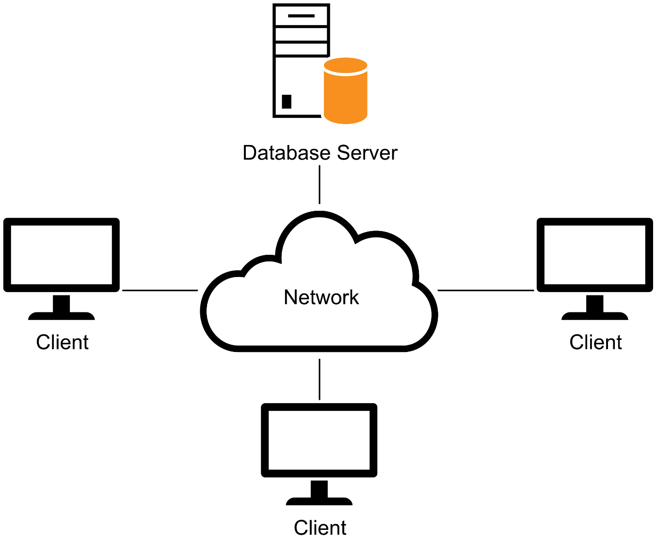
A simple client/server system

Slide 6
The three hardware components of a client/server system
Clients
Server
Network
Terms to know about client/server systems
Local area network (LAN)
Wide area network (WAN)
Enterprise system

Slide 7
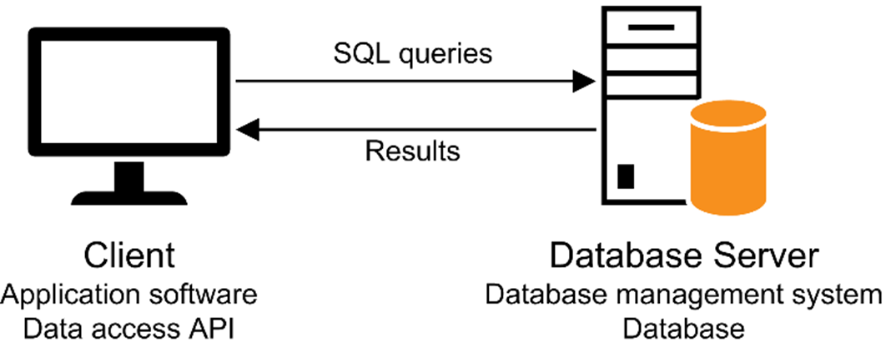
Client software, server software, and the SQL interface

Slide 8
Server software
Database management system (DBMS)
The DBMS does the back-end processing
Client software
Application software
Data access API (application programming interface)
The client software does the front-end processing

Slide 9
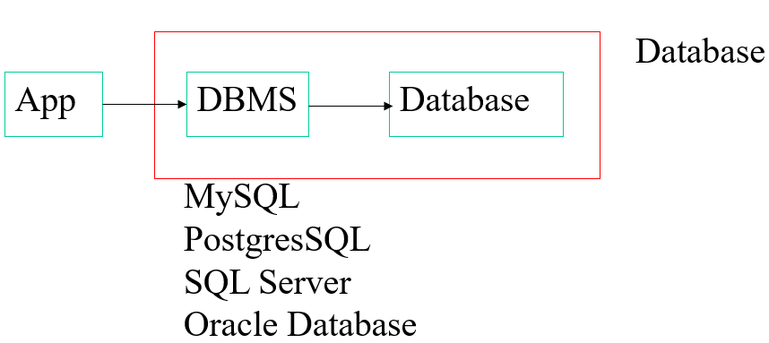
The SQL interface
The application software communicates with the DBMS by sending SQL queries through the data access API.
When the DBMS receives a query, it provides a service like returning the requested data (the query results) to the client.
SQL (Structured Query Language) is the standard language for working with a relational database.
It is the language used to interact with databases
Ex) English: Find all items that is over $10
SQL: SELECT * FROM Products WHERE price > 10;
All these relational DB use SQL
There are slight differences in SQL syntax among these databases
There is a standard SQL

Slide 10
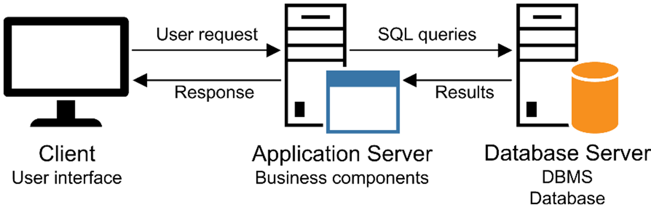
A networked system with an application server
ex: Java App Server, .NET Framework, PHP App Server, …
Compare:

Slide 11
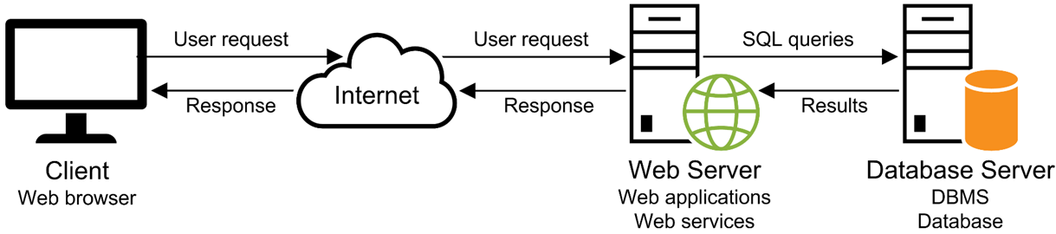
A simple web-based system
Most of the application servers have Web Server as integral part of them

Slide 12
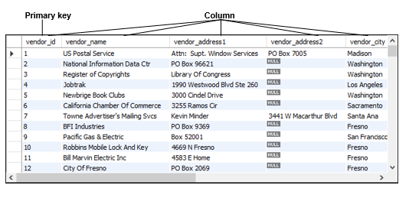
The Vendors table in an Accounts Payable (AP) database

Slide 13
Terms to know about database tables
Relational database
Table
Column
Row
Cell
Primary key
Composite primary key
Non-primary key (unique key)
Index

Slide 14
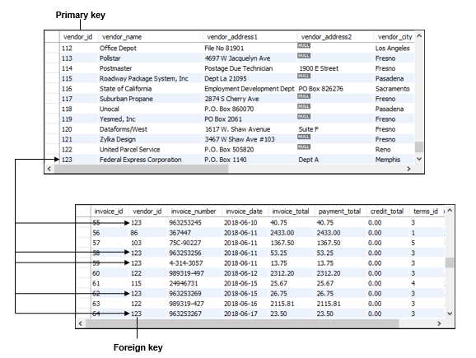
The relationship between two tables
Vendor
Invoice

Slide 15
Relation vs Relationship
Relation refers to a table
Relationship refers to the connection between tables
Why Relation?
The fundamental concept of Relational Database is based on Relational Algebra

Slide 16
Relational Algebra
Created by Edgar F. Codd in 1970
A theoretical foundation for relational databases
A relation is a set of tuples (d₁, d₂, ..., d_{n}), where each element d_{i} is a member of D, a data domain
Six basic operators
select: σ
project: ∏
union: ∪
set difference: –
Cartesian product: X
rename: ρ
The operators take one or two relations as inputs and produce a new relation as a result.

Slide 17
Terms to know about table relationships
Foreign key
Referential integrity
One-to-many relationship
One-to-one relationship
Many-to-many relationship

Slide 18
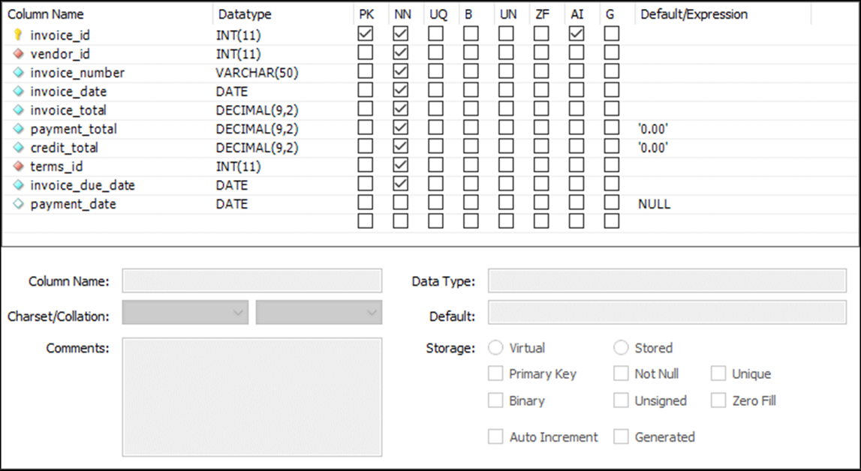
The columns of the Invoices table

Slide 19
Common MySQL data types
CHAR, VARCHAR
INT, DECIMAL
FLOAT
DATE

Slide 20
Terms to know about columns
Data type
Null value
Default value
Auto increment column

Slide 21
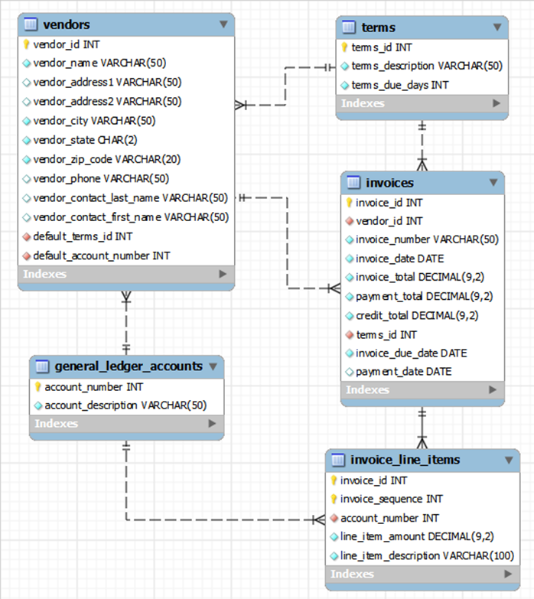
ER (Entity Relationship) diagram for the AP (Accounts Payable) database
The relationship between vendors and invoices is one to many
The foreign key is on the many side

Slide 22
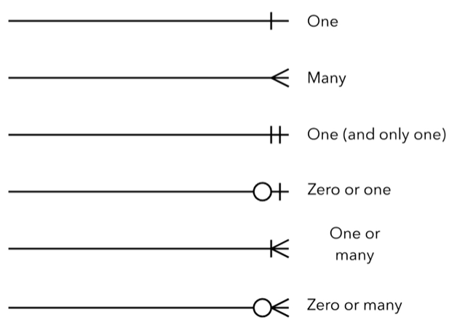
ER Diagram Cardinality
This notation is called Craw Foot notation

Slide 23
How knowing “standard SQL” helps you
Basic SQL statements are the same for all dialects.
Once you know one dialect, you can easily learn others.
How knowing “standard SQL” does not help you
Most applications require modification when moved to another database.

Slide 24
First database releases
Oracle 1979
DB2 1985
SQL Server 1987
MySQL 1995
Primary platforms
Oracle Unix OS/390 and z/OS
DB2 OS/390 and z/OS Unix
SQL Server Windows
MySQL Unix Windows Mac OS
Note that these are all relational databases
There were other kinds of databases before RDB
Hierarchical DB
Network DB

Slide 25
SQL DML statements
SELECT (sometimes called DQL)
INSERT
UPDATE
DELETE
SQL DDL statements
CREATE DATABASE, TABLE, INDEX
ALTER TABLE, INDEX
DROP DATABASE, TABLE, INDEX
SQL DCL statements
GRANT, REVOKE

Slide 26
A statement that creates a new database
CREATE DATABASE ap
A statement that selects the current database
USE ap

Slide 27
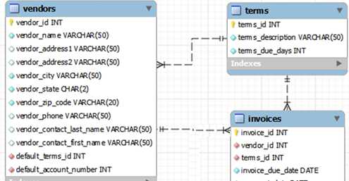
A statement that creates a new table
CREATE TABLE invoices
(
invoice_id INT PRIMARY KEY AUTO_INCREMENT,
vendor_id INT NOT NULL,
invoice_number VARCHAR(50) NOT NULL,
invoice_date DATE NOT NULL,
invoice_total DECIMAL(9,2) NOT NULL,
payment_total DECIMAL(9,2) DEFAULT 0,
credit_total DECIMAL(9,2) DEFAULT 0,
terms_id INT NOT NULL,
invoice_due_date DATE NOT NULL,
payment_date DATE,
CONSTRAINT invoices_fk_vendors
FOREIGN KEY (vendor_id)
REFERENCES vendors (vendor_id),
CONSTRAINT invoices_fk_terms
FOREIGN KEY (terms_id)
REFERENCES terms (terms_id)
);
Notes:
invoices_fk_vendors is a constraint that tells vendor_id is a foreign key to vendor_id in the vendors table.

Slide 28
A statement that modifies a table
A statement that adds a new column to a table
ALTER TABLE invoices ADD balance_due DECIMAL(9,2);
A statement that deletes the new column
ALTER TABLE invoices DROP COLUMN balance_due;
A statement that creates an index on the table
CREATE INDEX invoices_vendor_id_index
ON invoices (vendor_id);
A statement that deletes the new index
DROP INDEX invoices_vendor_id_index;

Slide 29
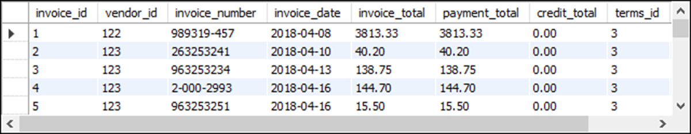
The Invoices table

Slide 30
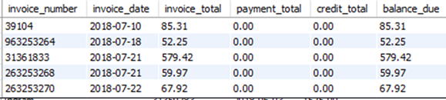
A SELECT statement that retrieves and sorts selected columns and rows
SELECT invoice_number, invoice_date, invoice_total,
payment_total, credit_total,
invoice_total - payment_total - credit_total AS balance_due
FROM invoices
WHERE invoice_total - payment_total - credit_total > 0
ORDER BY invoice_date;
The result set defined by the SELECT statement

Slide 31
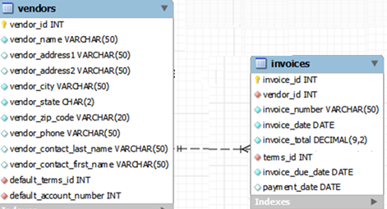
A SELECT statement that joins data
SELECT vendor_name, invoice_number, invoice_date, invoice_total
FROM vendors INNER JOIN invoices
ON vendors.vendor_id = invoices.vendor_id
WHERE invoice_total >= 500
ORDER BY vendor_name, invoice_total DESC;
Note that to retrieve results from multiple tables, those tables need to be JOINed

Slide 32
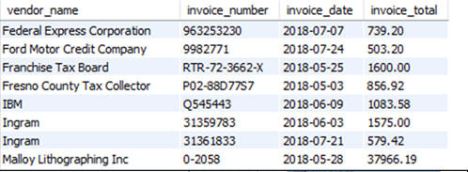
A SELECT statement that joins data
The result set defined by the SELECT statement

Slide 33
Terms to know about SQL
Query
Base table
Result table (result set)
Calculated value
Join
Inner join
Outer join

Slide 34
A statement that adds a row to the Invoices table
INSERT INTO invoices
(vendor_id, invoice_number, invoice_date,
invoice_total, terms_id, invoice_due_date)
VALUES (12, '3289175', '2018-07-18', 165, 3, '2018-08-17');

Slide 35
A statement that changes the value of a column for one row
UPDATE invoices
SET credit_total = 35.89
WHERE invoice_number = '367447’;
A statement that changes the value of a column for multiple rows
UPDATE invoices
SET invoice_due_date
= DATE_ADD(invoice_due_date, INTERVAL 30 DAY)
WHERE terms_id = 4;

Slide 36
A statement that deletes a selected invoice from the Invoices table
DELETE FROM invoices
WHERE invoice_number = '4-342-8069';
A statement that deletes all paid invoices from the Invoices table
DELETE FROM invoices
WHERE invoice_total - payment_total - credit_total = 0;

Slide 37
A SELECT statement that’s difficult to read
select invoice_number, invoice_date, invoice_total, payment_total, credit_total, invoice_total - payment_total – credit_total as balance_due from invoices where invoice_total – payment_total - credit_total > 0 order by invoice_date;
A SELECT statement that’s easy to read
SELECT invoice_number, invoice_date, invoice_total,
payment_total, credit_total,
invoice_total - payment_total - credit_total AS balance_due
FROM invoices
WHERE invoice_total - payment_total - credit_total > 0
ORDER BY invoice_date;
SELECT, FROM, WHERE, ORDER BY are called clauses

Slide 38
A SELECT statement with a block comment
/* Author: Joel Murach Date: 8/22/2018 */ SELECT invoice_number, invoice_date, invoice_total,
invoice_total - payment_total - credit_total
AS balance_due
FROM invoices;
A SELECT statement with a single-line comment
-- The fourth column calculates the balance due
SELECT invoice_number, invoice_date, invoice_total,
invoice_total - payment_total - credit_total
AS balance_due
FROM invoices;

Slide 39
Coding recommendations
Capitalize all keywords.
Use lowercase for the other code.
Separate the words in names with underscores.
Start each clause on a new line.
Break long clauses into multiple lines.
Indent continued lines.
Use comments only for code that is difficult to understand.
Make sure that the comments are correct and up-to-date.
Note
Line breaks, white space, indentation, and capitalization have no effect on the operation of a statement.
Reserved words (commands, data types, …) are case insensitive
DB names, table names, and column names are case sensitive in UNIX

Slide 40
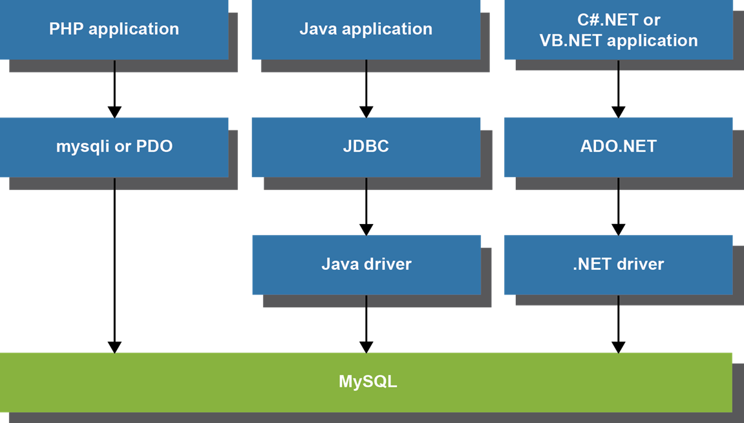
Common options for accessing MySQL data using programs
PDO: PHP Data Object

Slide 41
Terms to know about accessing MySQL data
Data access API
MySQL API (for PHP)
PDO API (for PHP)
JDBC API (for Java)
ADO.NET API (for .NET languages)
Database driver
Connector/J
Connector/Net

Slide 42
PHP code that gets data from MySQL (part 1)
<?php
$query =
"SELECT vendor_name, invoice_number, invoice_total
FROM vendors INNER JOIN invoices
ON vendors.vendor_id = invoices.vendor_id
WHERE invoice_total >= 500
ORDER BY vendor_name, invoice_total DESC";
$dsn = 'mysql:host=localhost;dbname=ap';
$username = 'root';
$password = 'sesame';
try {
$db = new PDO($dsn, $username, $password);
} catch (PDOException $e) {
$error_message = $e->getMessage();
echo $error_message;
exit();
}
$statement = $db->prepare($query);
$statement->execute();
$rows = $statement->fetchAll();
?>

Slide 43
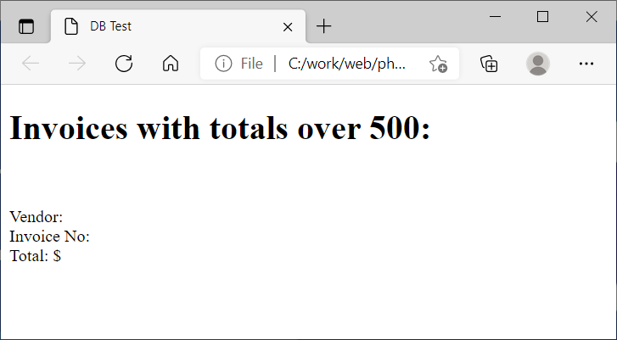
PHP code (part 2)
<!DOCTYPE html>
<html lang="en">
<head>
<title>DB Test</title>
</head>
<body>
<h1>Invoices with totals over 500:</h1>
<?php foreach ($rows as $row) : ?>
<p>
Vendor: <?php echo $row['vendor_name']; ?><br/>
Invoice No: <?php echo $row['invoice_number']; ?>
<br/>
Total: $<?php echo
number_format($row['invoice_total'], 2); ?>
</p>
<?php endforeach; ?>
</body>
</html>

Slide 44
Java code that gets data from MySQL (part 1)
import java.sql.*;
import java.text.NumberFormat;
public class DBTestApp
{
public static void main(String args[])
{
String query =
"SELECT vendor_name, invoice_number, invoice_total " +
"FROM vendors INNER JOIN invoices " +
"ON vendors.vendor_id = invoices.vendor_id " +
"WHERE invoice_total >= 500 " +
"ORDER BY vendor_name, invoice_total DESC";
String dbUrl = "jdbc:mysql://localhost:3306/ap";
String username = "root";
String password = "sesame";
try (Connection connection =
DriverManager.getConnection(dbUrl, username, password);
PreparedStatement ps = connection.prepareStatement(query);
ResultSet rs = ps.executeQuery())

Slide 45
Java code that gets data from MySQL (part 2)
{
System.out.println("Invoices with totals over 500:\n");
while(rs.next())
{
String vendorName = rs.getString("vendor_name");
String invoiceNumber =
rs.getString("invoice_number");
double invoiceTotal = rs.getDouble("invoice_total");
NumberFormat currency = NumberFormat.getCurrencyInstance();
String invoiceTotalString = currency.format(invoiceTotal);
System.out.println(
"Vendor: " + vendorName + "\n" +
"Invoice No: " + invoiceNumber + "\n" +
"Total: " + invoiceTotalString + "\n");
}
}
catch(SQLException e) {
System.out.println(e.getMessage());
}
}
}

Slide 46
Chapter 2
How to use MySQL Workbench and other development tools

Slide 47
Objectives
Start or stop the MySQL database server.
Use MySQL Workbench to do any of the following:
Create a database connection
Navigate through the objects of a database
View the column definitions for a table
View the data for a table
Edit the column definitions for a table
Use MySQL Workbench to enter, run, open, and save SQL statements and scripts.
Use the MySQL Reference Manual to look up information about SQL statements.

Slide 48
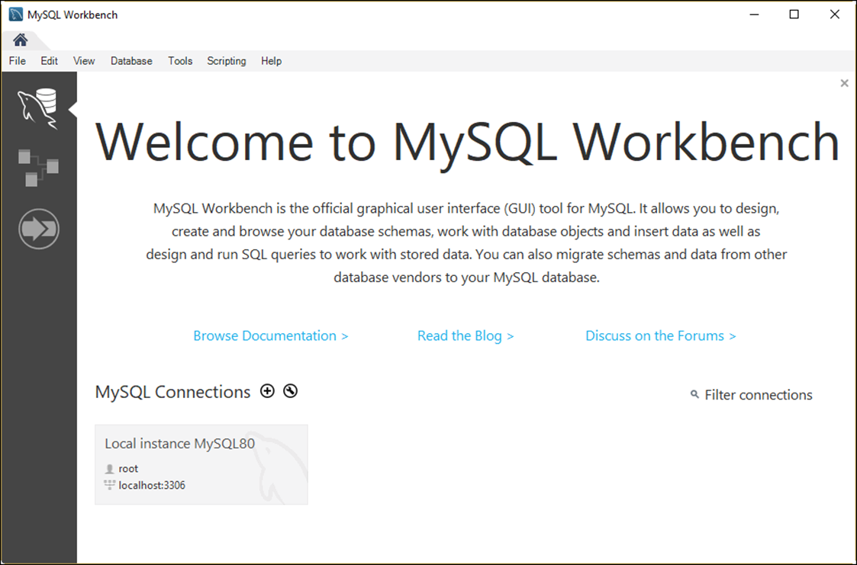
The Home page of MySQL Workbench

Slide 49
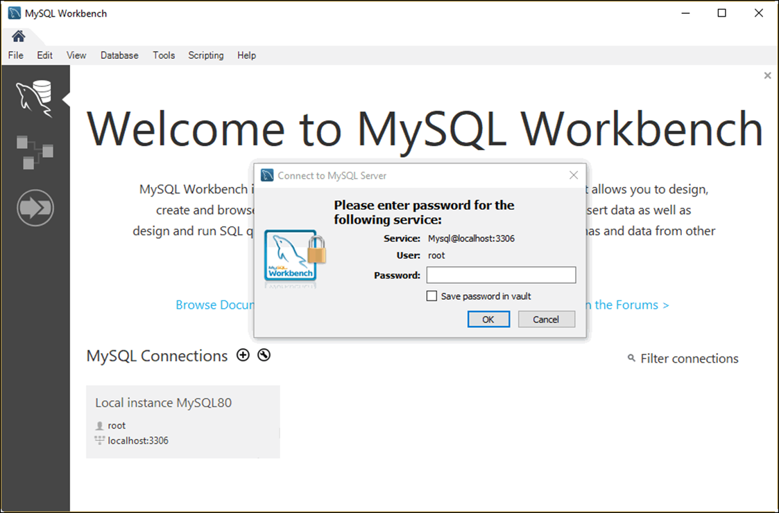
The dialog box for opening database connections

Slide 50
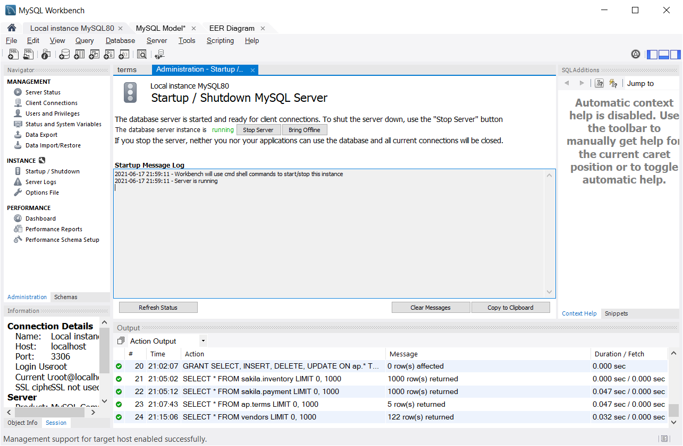
The Startup/Shutdown option of MySQL Workbench

Slide 51
How to stop and start the database server
In the Navigator window, select the Startup/Shutdown option.
Click the Stop Server button to stop the database server. Or, click the Start Server button to start it.
Note
After you install MySQL, the database server usually starts automatically each time you start your computer.

Slide 52
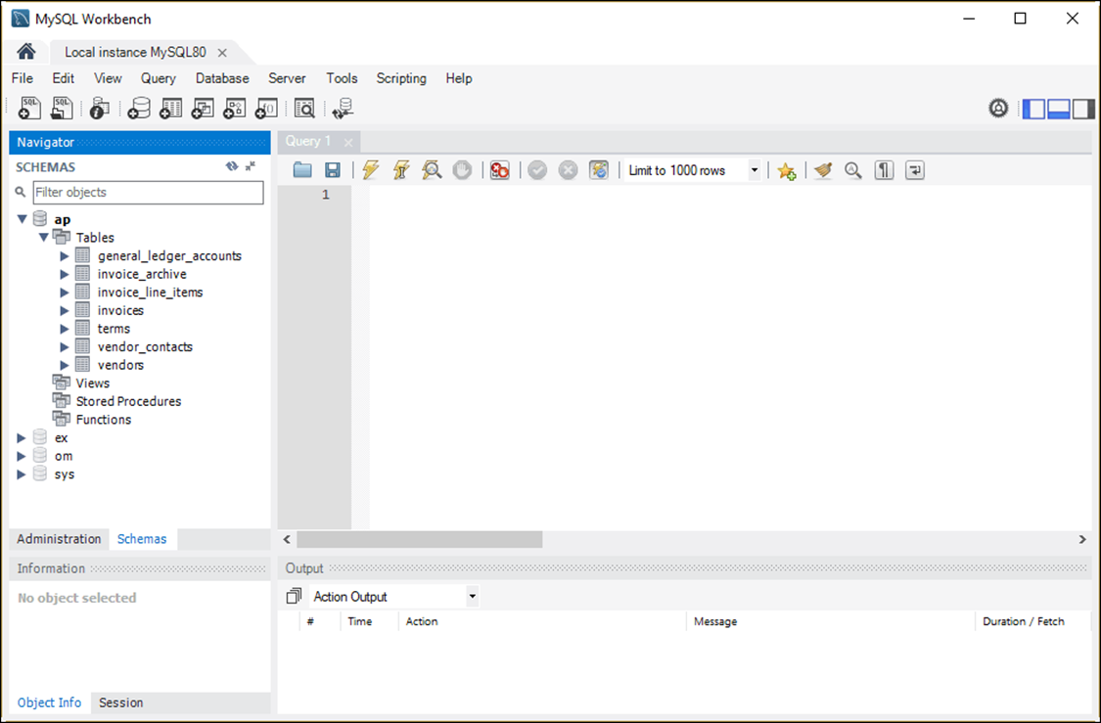
The tables available for the AP database

Slide 53
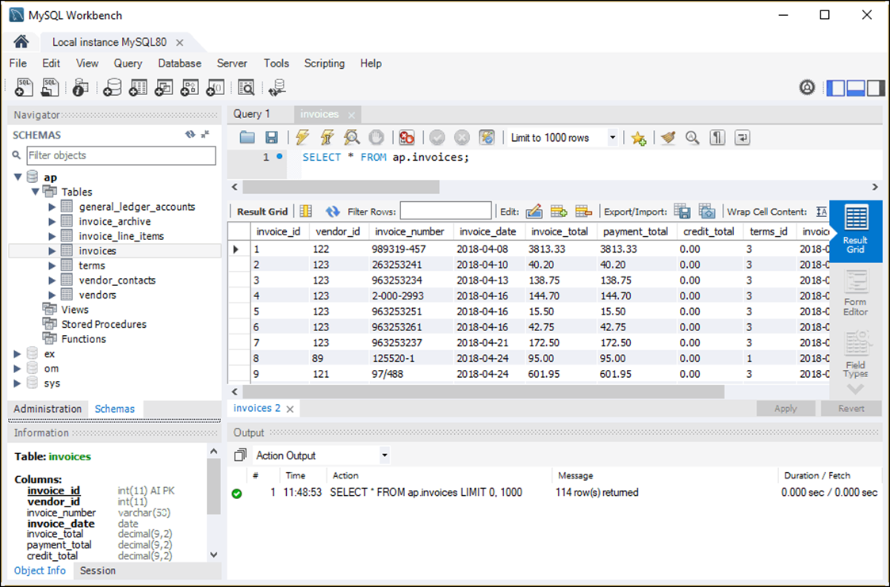
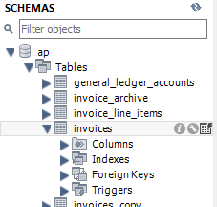
The data for the Invoices table in a Result grid

Slide 54
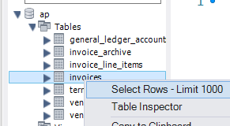
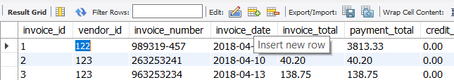
How to view the data for a table
Right-click the table in the Schemas section of the Navigator window.
Select the Select Rows - Limit 1000 command to display it in a Result grid.
How to edit the data for a table
View the data.
Use the buttons at the top of the Result grid to insert, update, and delete rows.
Click the Apply button at the bottom of the tab to apply the changes.

Slide 55
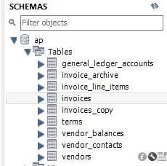
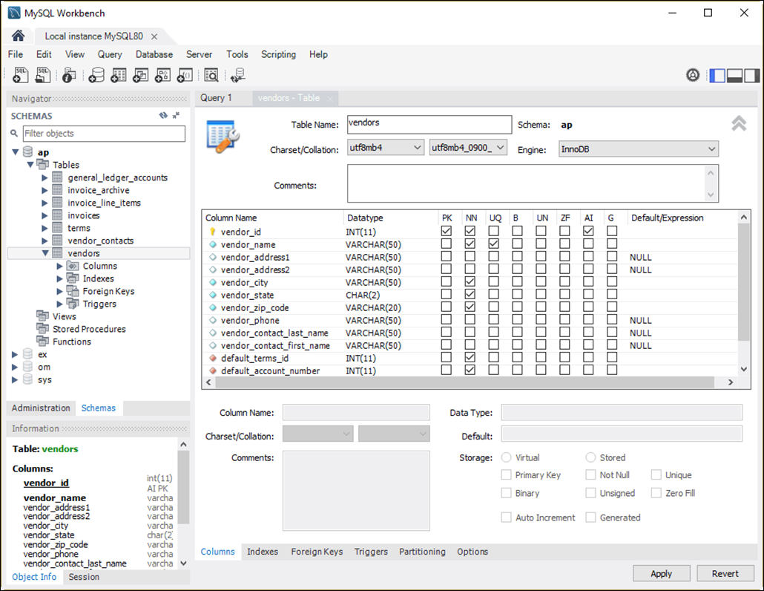
The column definitions for the Vendors table

Slide 56
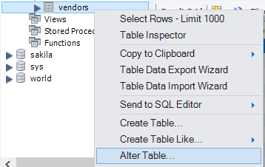
How to view the column definitions
Right-click the table name in the Navigator window and select the Alter Table command.
Select the Columns tab at the bottom of the window that’s displayed.
How to edit the column definitions
View the column definitions.
Use the resulting window to add new columns and modify and delete existing columns.
To add a column, click the Column Name field in an empty row and enter an appropriate value.

Slide 57
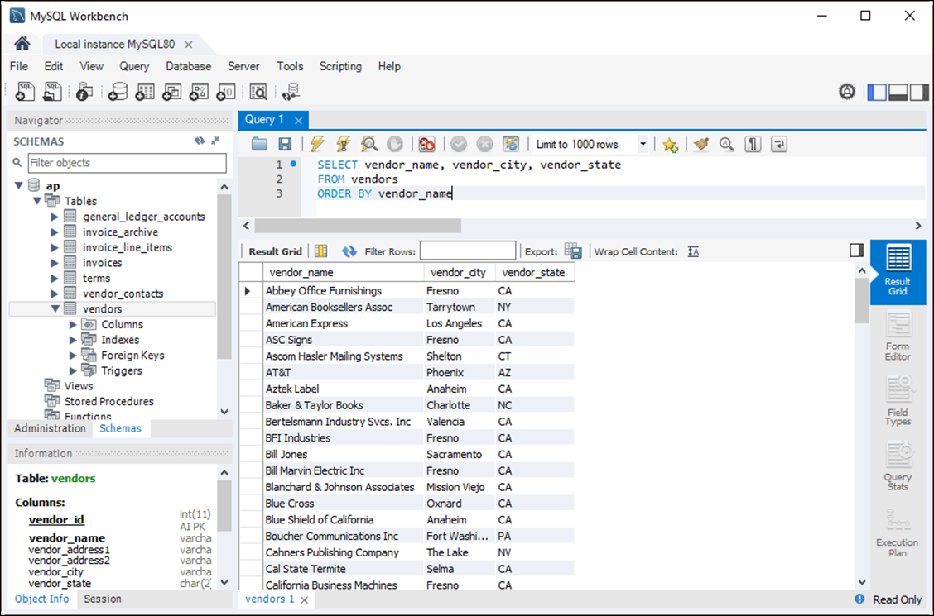
A SELECT statement and its results

Slide 58
How to enter a SQL statement
Press Ctrl+T or click the Create New SQL Tab button in the SQL Editor toolbar to open a new code editor tab.
Type the SQL statement into the SQL editor.
How to execute a SQL statement
Press Ctrl+Enter or click the Execute Current Statement button in the SQL Editor toolbar.
If the statement retrieves data, the data is displayed in a Result grid.

Slide 59
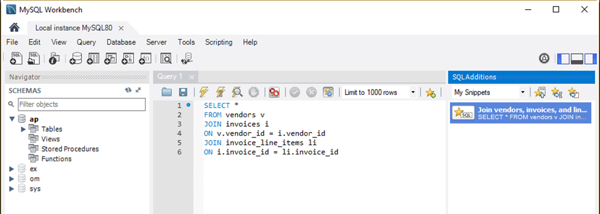
The SQL Additions tab with a snippet created by a user
SQL Snippets allow you to save SQL code as a snippet, and then you or other SQL authors can refer to that snippet later on

Slide 60
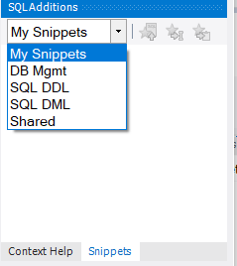
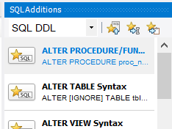
How to use a snippet
To display any category of snippets, select the category from the drop-down list at the top of the Snippets tab.
Select the snippet and then click the Insert Snippet button at the top of the Snippets tab.
Edit the snippet code so it’s appropriate for your SQL statement.
How to replace code with a snippet
Select the code.
Select the snippet you want to replace the code with.
Click the Replace Current Text button.

Slide 61

How to create your own snippet
Enter the code for the snippet into a SQL editor tab.
Select the category where you want to save the snippet.
Click the Save Snippet button ( ) in the SQL Editor toolbar, and enter a name for the snippet.
How to delete a snippet
Right-click the snippet in the Snippets tab.
Select the Delete Snippet item.

Slide 62
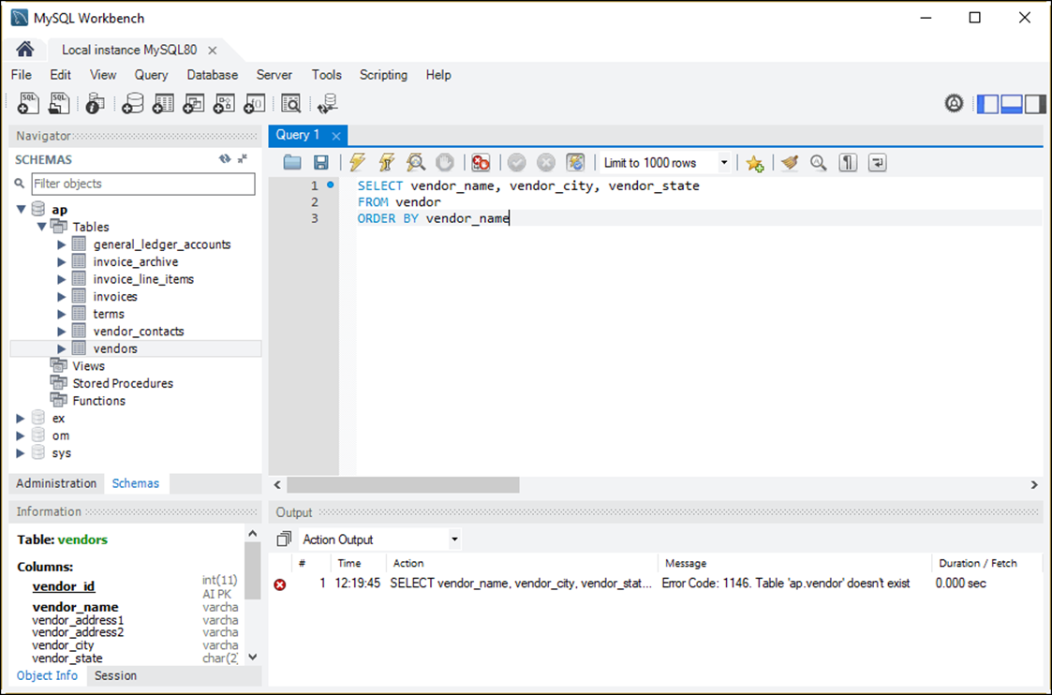
How to handle syntax errors

Slide 63
Common causes of errors
Having the wrong database selected
Misspelling the name of a table or column
Misspelling a keyword
Omitting the closing quotation mark for a character string

Slide 64
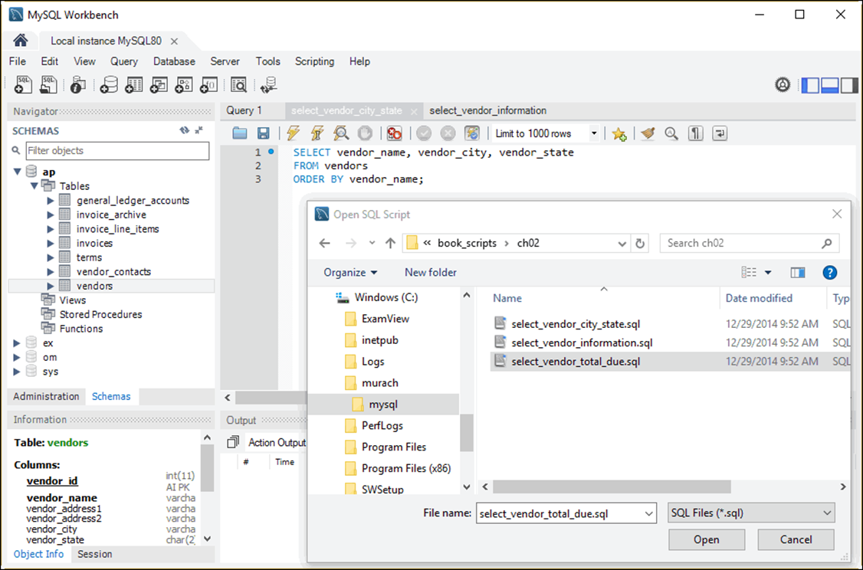
The Open SQL Script dialog box

Slide 65
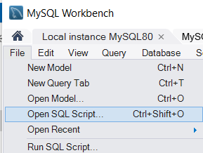
How to open a SQL script
Click the Open SQL Script File button in the SQL Editor toolbar or press the Ctrl+Shift+O keys.
Use the Open SQL Script dialog box to locate and open the SQL script.

Slide 66
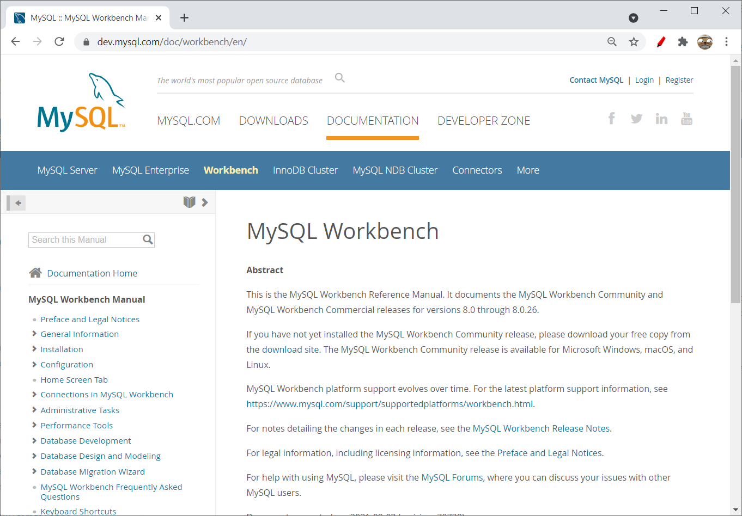
MySQL 8.0 Reference Manual
https://dev.mysql.com/doc/workbench/en/

Slide 67
The syntax of the mysql command
mysql –h hostname –u username –p
Examples of the mysql command
mysql –u ap_tester -p
mysql –h localhost –u root –p
mysql –h murach.com –u ap_tester –p
How to exit the MySQL Command Line Client
mysql> exit;

Slide 68
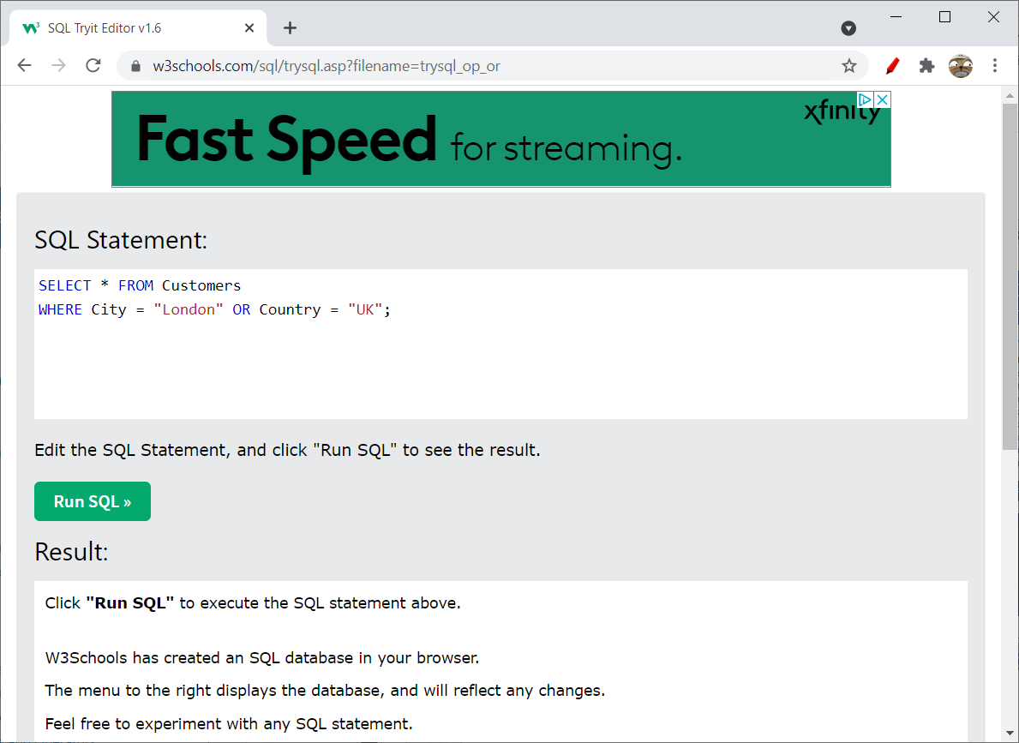
Try-It SQL Editor
https://www.w3schools.com/sql/trysql.asp?filename=trysql_op_or
Interactive browser based SQL environment

Slide 69
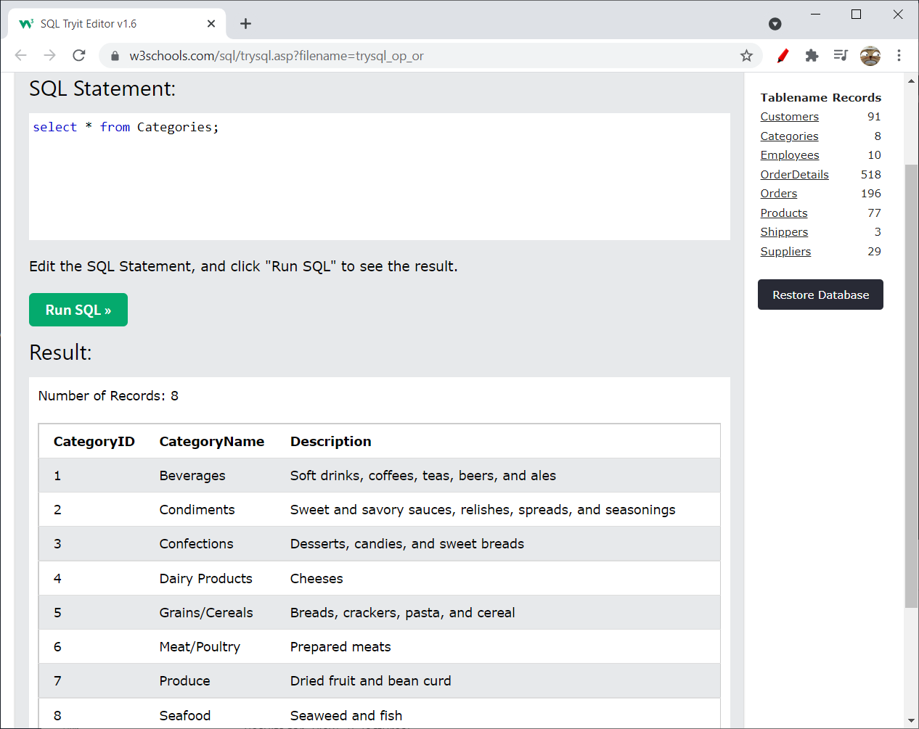
Select * from Categories;

Slide 70
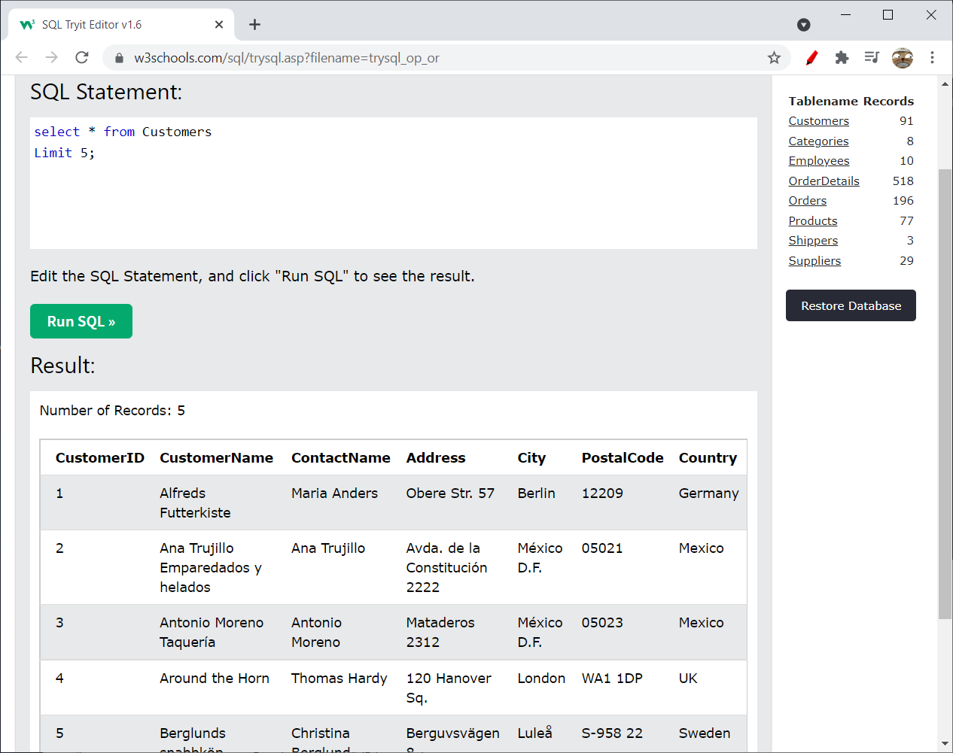

Slide 71
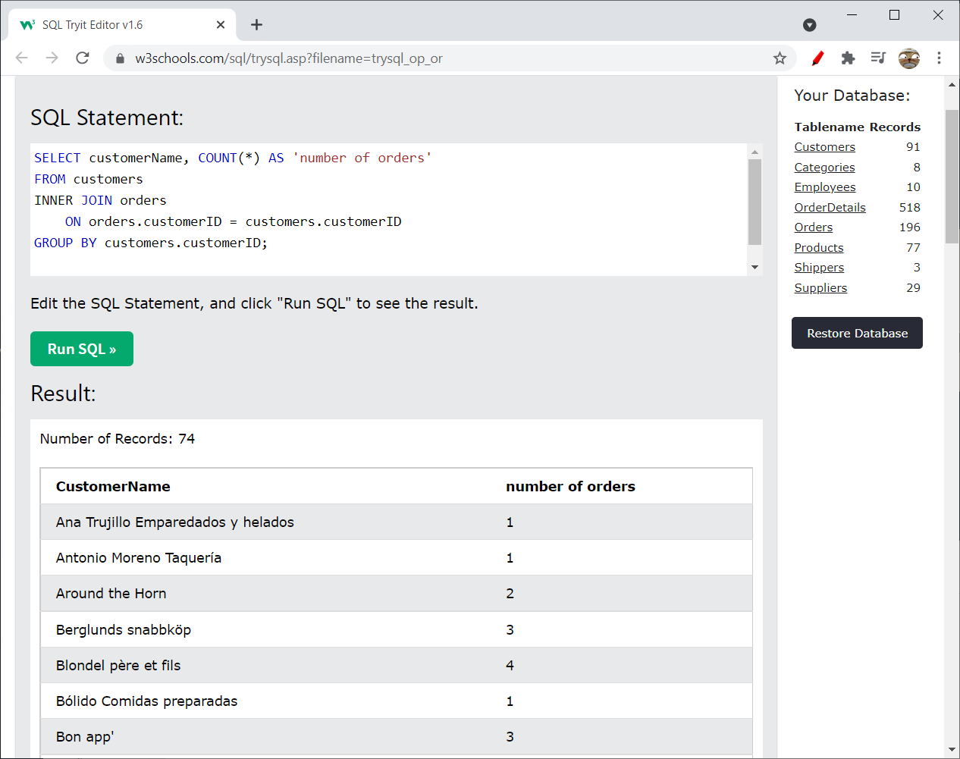

Slide 72
Cloud Based MySQL
PC users, Mac users, and Linux users can equally use regardless of machine types or capabilities
Installation is easy
Cloud9 (bought from Amazon)
Google Cloud MySQL
GoormIDE

Slide 73
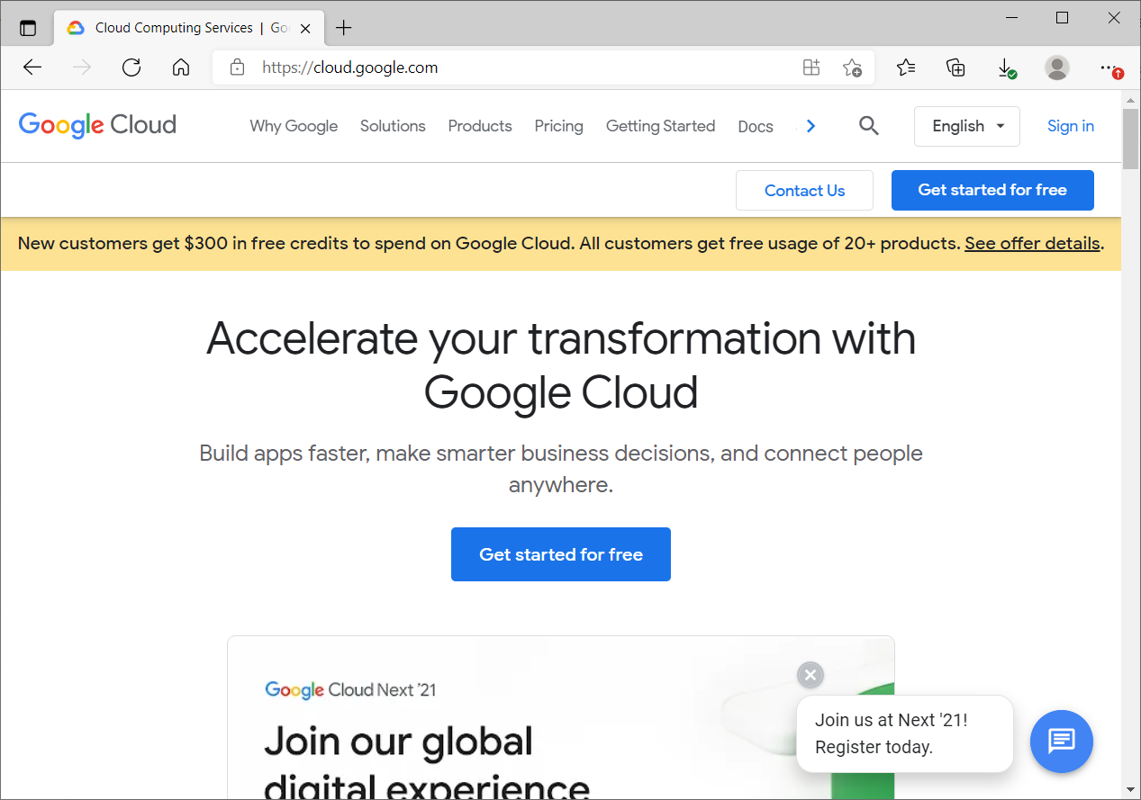
Creating Google Account
cloud.google.com – for getting free Google Cloud account

Slide 74
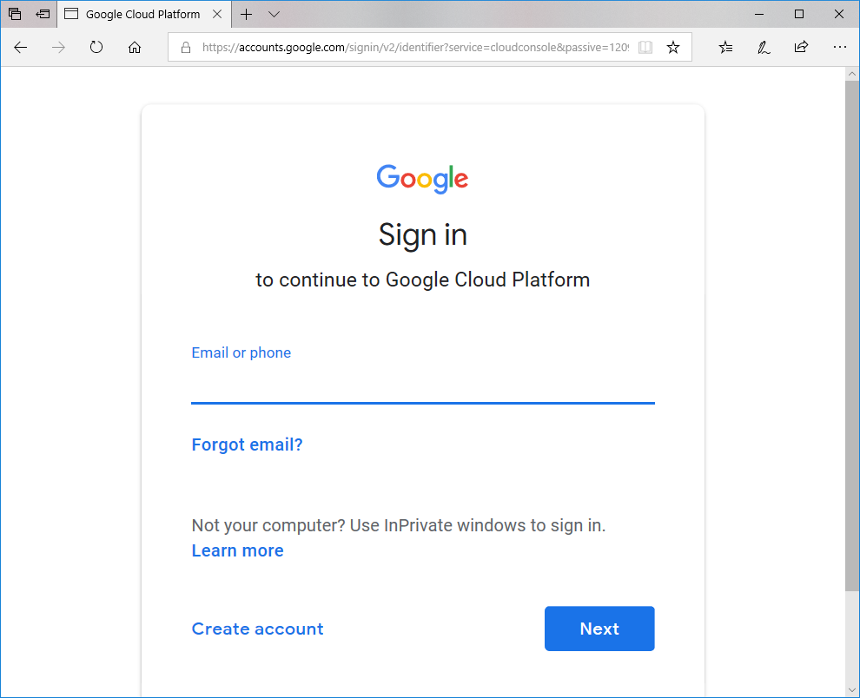
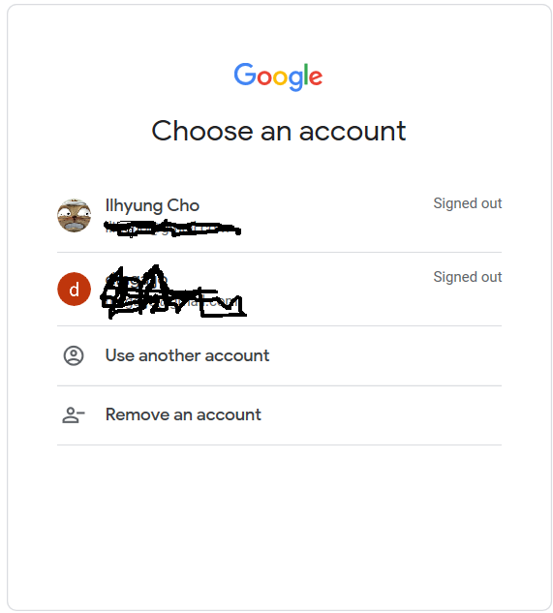
Enter your google account
If you already signed in to google account, you will see your account displayed

Slide 75
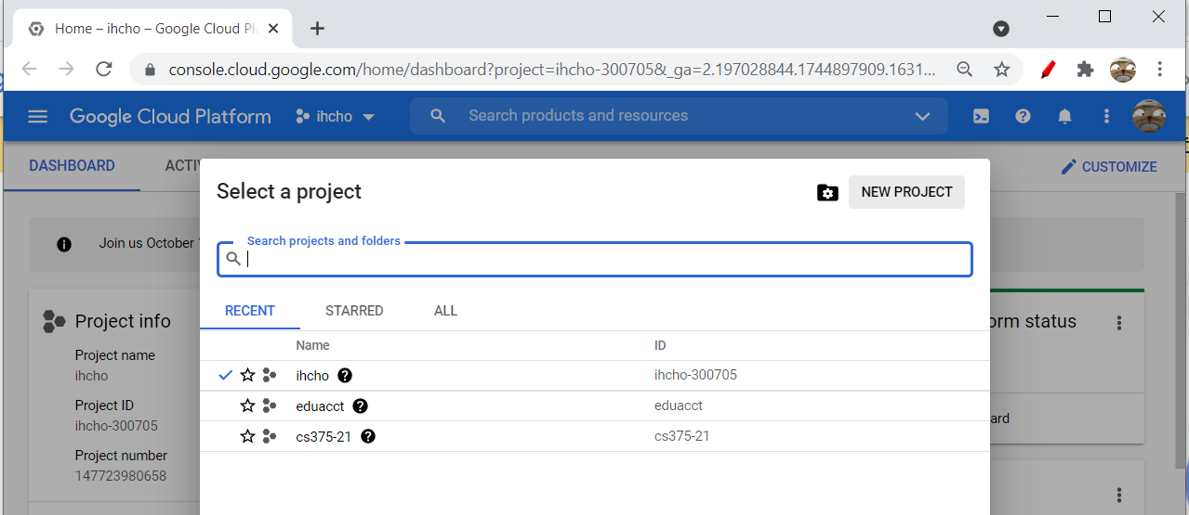
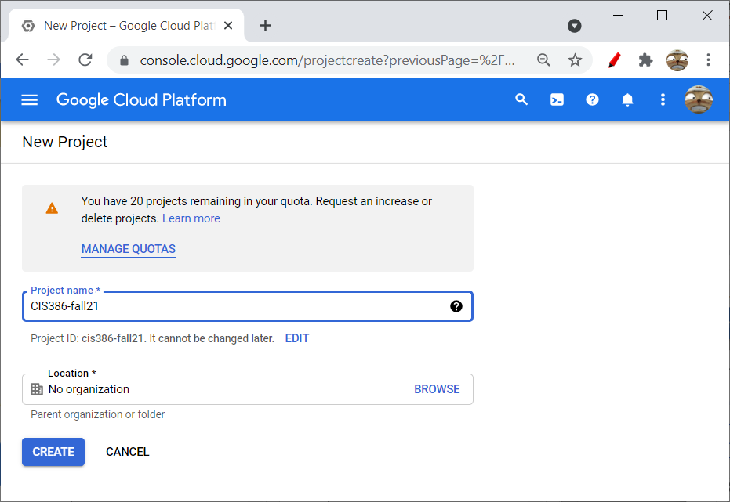
Creating a new project

Slide 76
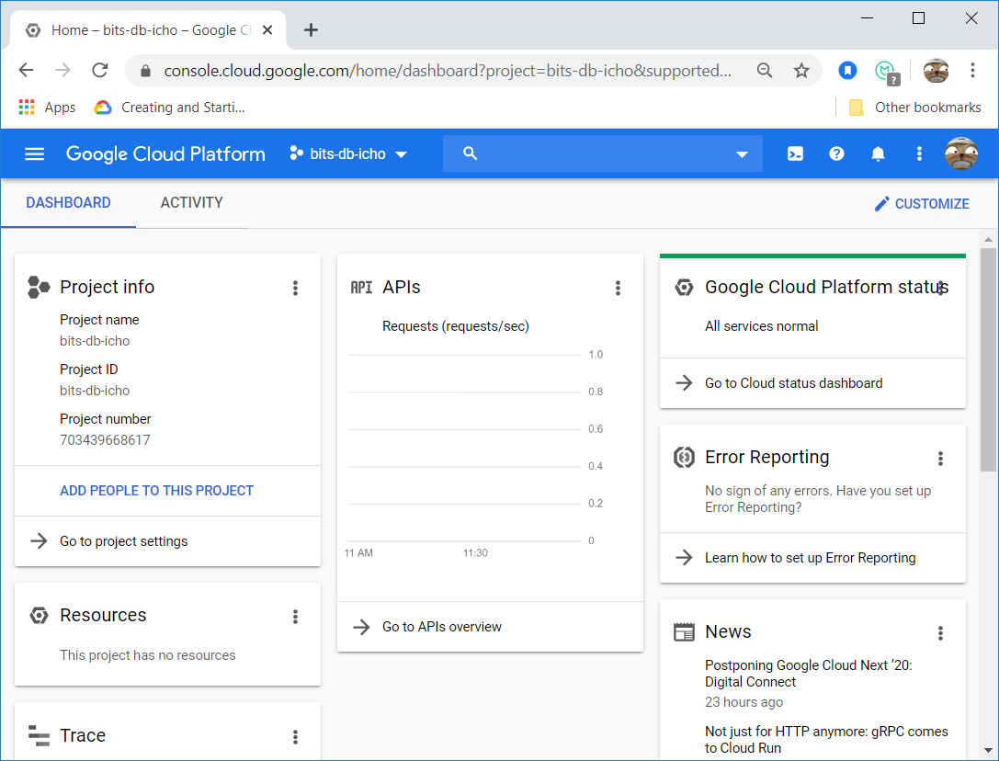
The small panels (called Cards) can be rearranged by clicking on the top of each panel and moving to other location

Slide 77
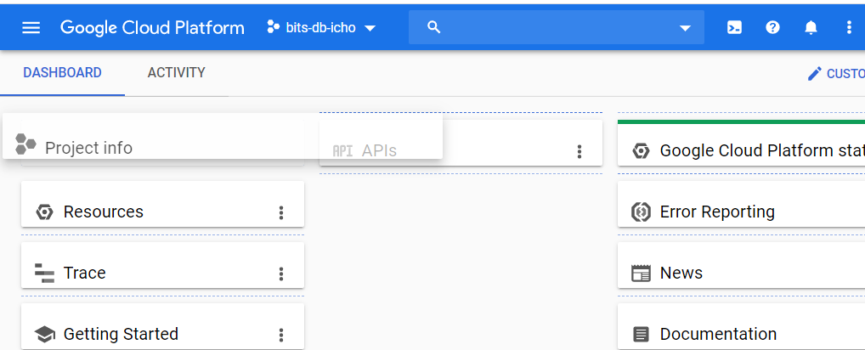
Project Info is clicked and the panels are minimized

Slide 78
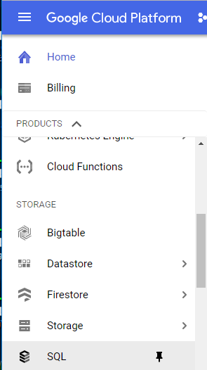
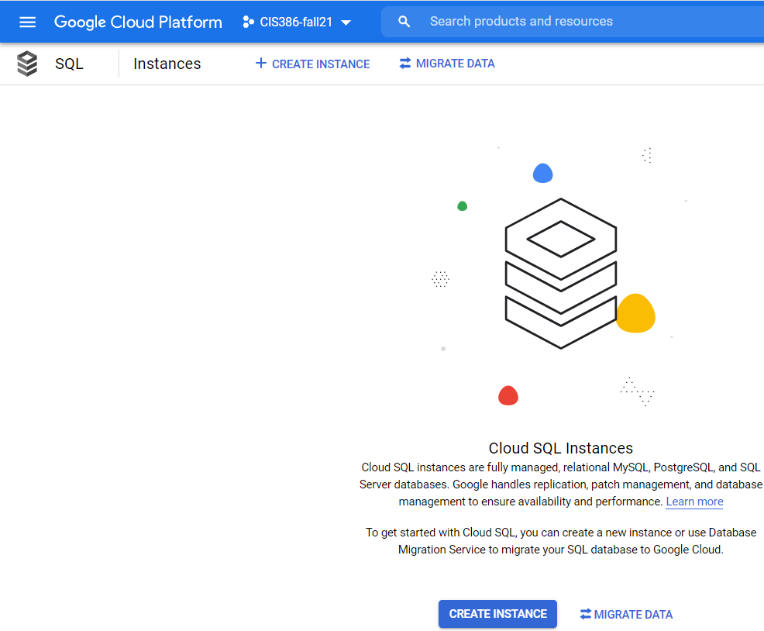
Creating Cloud SQL Instance
Click here
Click on SQL
Click on Create Instance

Slide 79
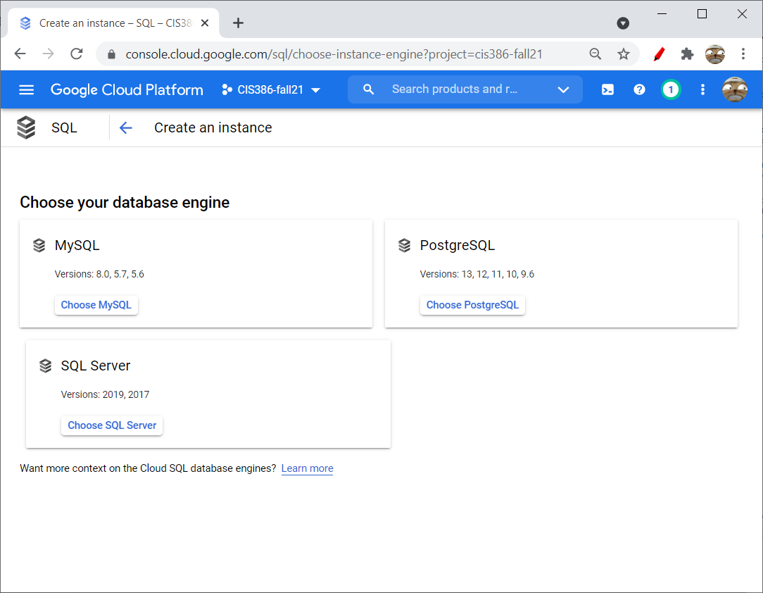


Slide 80

Enter instance name and password, select region and zone, and then Create
To make things simple, you can check on “No password”

Slide 81

The MySQL database instance is created. It may take a minute or two.

Slide 82

Connecting To MySQL using Shell
Open Google Cloud Platform Console

Slide 83


Slide 84

Enter: gcloud sql connect mysqlinstance --user=root
When asked for password, hit enter (if you did not specify the password)

Slide 85

mysql> show databases;
+--------------------+
| Database |
+--------------------+
| information_schema |
| mysql |
| performance_schema |
| sys |
+--------------------+
4 rows in set (0.04 sec)
mysql>
To exit from the database, type quit and <Enter>
Play around a little bit and close the terminal

Slide 86
Chapter 3
How to retrieve data from a single table

Slide 87
Objectives
Code SELECT statements that require any of the language elements presented in this chapter.
Distinguish between the base table values and the calculated values in SELECT statements.
Describe the use of a column alias.
Describe the order of precedence and the use of parentheses for arithmetic expressions.
Describe the use of the CONCAT function in string expressions.
Describe the use of functions with strings, dates, and numbers.
Describe the use of the DISTINCT keyword.
Describe the use of comparison operators, logical operators, and parentheses in WHERE clauses.
Describe the use of the IN, BETWEEN, and LIKE operators in WHERE clauses.
Describe the use of IS NULL in a WHERE clause.
Describe the use of column names, column aliases, calculated values, and column numbers in ORDER BY clauses.

Slide 88
The basic syntax of the SELECT statement
SELECT select_list
[FROM table_source] [WHERE search_condition] [ORDER BY order_by_list]
[LIMIT row_limit]
The five clauses of the SELECT statement
SELECT
FROM
WHERE
ORDER BY
LIMIT

Slide 89

A simple SELECT statement
SELECT * FROM invoices

Slide 90

A SELECT statement that retrieves and sorts rows
SELECT invoice_number, invoice_date, invoice_total
FROM invoices
ORDER BY invoice_total DESC

Slide 91


A SELECT statement that retrieves a calculated value
SELECT invoice_id, invoice_total,
credit_total + payment_total AS total_credits
FROM invoices
WHERE invoice_id = 17
Note that the keyword AS is optional

Slide 92

A SELECT statement that retrieves all invoices between given dates
SELECT invoice_number, invoice_date, invoice_total
FROM invoices
WHERE invoice_date BETWEEN '2018-06-01' AND '2018-06-30'
ORDER BY invoice_date
Invalid values will cause a warning and no result may be displayed

Slide 93
A SELECT statement that returns an empty result set
SELECT invoice_number, invoice_date, invoice_total
FROM invoices
WHERE invoice_total > 50000

Slide 94
The expanded syntax of the SELECT clause
SELECT [ALL|DISTINCT]
column_specification [[AS] result_column]
[, column_specification [[AS] result_column]]
...
Four ways to code column specifications
All columns in a base table
Column name in a base table
Calculation
Function

Slide 95
Column specifications that use base table values
The * is used to retrieve all columns
SELECT *
Column names are used to retrieve specific columns
SELECT vendor_name, vendor_city, vendor_state

Slide 96
Column specifications that use calculated values
An arithmetic expression that calculates the balance due
SELECT invoice_total - payment_total – credit_total
AS balance_due
A function that returns the full name
SELECT CONCAT(first_name, ' ', last_name) AS full_name

Slide 97

A SELECT statement that renames the columns in the result set
SELECT invoice_number AS "Invoice Number",
invoice_date AS Date, invoice_total AS Total
FROM invoices

Slide 98

A SELECT statement that doesn’t name a calculated column
SELECT invoice_number, invoice_date, invoice_total,
invoice_total - payment_total - credit_total
FROM invoices

Slide 99
The arithmetic operators in order of precedence
Operator Name Order of precedence
* Multiplication 1
/ Division 1
DIV Integer division 1
% (MOD) (remainder) 1
+ Addition 2
- Subtraction 2

Slide 100

A SELECT statement that calculates the balance due
SELECT invoice_total, payment_total, credit_total,
invoice_total - payment_total - credit_total
AS balance_due
FROM invoices

Slide 101

Use parentheses to control the sequence of operations
SELECT invoice_id,
invoice_id + 7 * 3 AS multiply_first,
(invoice_id + 7) * 3 AS add_first
FROM invoices
ORDER BY invoice_id

Slide 102

Use the DIV and modulo operators
SELECT invoice_id,
invoice_id / 3 AS decimal_quotient,
invoice_id DIV 3 AS integer_quotient,
invoice_id % 3 AS remainder
FROM invoices
ORDER BY invoice_id

Slide 103

The syntax of the CONCAT function
CONCAT(string1[, string2]...)
How to concatenate string data
SELECT vendor_city, vendor_state,
CONCAT(vendor_city, vendor_state)
FROM vendors

Slide 104

How to format string data using literal values
SELECT vendor_name,
CONCAT(vendor_city, ', ', vendor_state, ' ',
vendor_zip_code) AS address
FROM vendors

Slide 105

How to include apostrophes in literal values
SELECT CONCAT(vendor_name, '''s Address: ') AS Vendor,
CONCAT(vendor_city, ', ', vendor_state, ' ',
vendor_zip_code) AS Address
FROM vendors
The following also works:
CONCAT(vendor_name, "'s Address: ") AS Vendor

Slide 106
Terms to know
Function
Parameter
Argument
Concatenate

Slide 107

The syntax of the LEFT function
LEFT(string, number_of_characters)
Extract first number of characters from the left
A SELECT statement that uses the LEFT function
SELECT vendor_contact_first_name, vendor_contact_last_name,
CONCAT(LEFT(vendor_contact_first_name, 1),
LEFT(vendor_contact_last_name, 1)) AS initials
FROM vendors

Slide 108

The syntax of the DATE_FORMAT function
DATE_FORMAT(date, format_string)
Ex)
SELECT invoice_date,
DATE_FORMAT(invoice_date, '%m/%d/%y') AS 'MM/DD/YY',
DATE_FORMAT(invoice_date, '%e-%b-%Y') AS 'DD-Mon-YYYY'
FROM invoices
ORDER BY invoice_date
Note
%d keeps the leading 0, while %e does not
%m is for numeral months and %b is for month names

Slide 109

The syntax of the ROUND function
ROUND(number[, number_of_decimal_places])
Default value of number_of_decimal_places is 0
A SELECT statement that uses the ROUND function
SELECT invoice_date, invoice_total,
ROUND(invoice_total) AS nearest_dollar,
ROUND(invoice_total, 1) AS nearest_dime
FROM invoices
ORDER BY invoice_date

Slide 110

A SELECT statement that tests a calculation
SELECT 1000 * (1 + .1) AS "10% More Than 1000“
Note that there is no FROM clause

Slide 111

A SELECT statement that tests the CONCAT function
SELECT "Ed" AS first_name, "Williams" AS last_name,
CONCAT(LEFT("Ed", 1), LEFT("Williams", 1)) AS initials
Note that the following does not work
SELECT "Ed" AS first_name, "Williams" AS last_name,
CONCAT(LEFT(first_name, 1), LEFT(last_name, 1)) AS initials
Error Code: 1054. Unknown column 'first_name' in 'field list'

Slide 112

A SELECT statement that tests the DATE_FORMAT function
SELECT CURRENT_DATE,
DATE_FORMAT(CURRENT_DATE, '%m/%d/%y') AS 'MM/DD/YY',
DATE_FORMAT(CURRENT_DATE, '%e-%b-%Y') AS 'DD-Mon-YYYY'

Slide 113

A SELECT statement that tests the ROUND function
SELECT 12345.6789 AS value,
ROUND(12345.6789) AS nearest_dollar,
ROUND(12345.6789, 1) AS nearest_dime

Slide 114


A SELECT statement that returns all rows
SELECT vendor_city, vendor_state
FROM vendors
ORDER BY vendor_city
A SELECT statement that eliminates duplicate rows
SELECT DISTINCT vendor_city, vendor_state
FROM vendors
ORDER BY vendor_city

Slide 115
The syntax of the WHERE clause with comparison operators
WHERE expression_1 operator expression_2
The comparison operators
=
<
>
<=
>=
<>
!=

Slide 116
Examples of WHERE clauses that retrieve…
Vendors located in Iowa
WHERE vendor_state = 'IA’
Invoices with a balance due (two variations)
WHERE invoice_total – payment_total – credit_total > 0
WHERE invoice_total > payment_total + credit_total
Vendors with names from A to L
WHERE vendor_name < 'M’
Invoices on or before a specified date
WHERE invoice_date <= '2018-07-31’
Invoices on or after a specified date
WHERE invoice_date >= '2018-07-01’
Invoices with credits that don’t equal zero (two variations)
WHERE credit_total <> 0
WHERE credit_total != 0

Slide 117
The syntax of the WHERE clause with logical operators
WHERE [NOT] search_condition_1 {AND|OR}
[NOT] search_condition_2 ...
Examples
The AND operator
WHERE vendor_state = 'NJ' AND vendor_city = 'Springfield'
The OR operator
WHERE vendor_state = 'NJ' OR vendor_city = 'Pittsburg'
The NOT operator
WHERE NOT vendor_state = 'CA'

Slide 118
Examples (continued)
The NOT operator in a complex search condition
WHERE NOT (invoice_total >= 5000 OR NOT invoice_date <= '2018-08-01')
The same condition rephrased to eliminate the NOT operator
WHERE invoice_total < 5000
AND invoice_date <= '2018-08-01'
Note that Not (A OR B) is same as (Not A) AND (Not B)

Slide 119

A compound condition without parentheses
WHERE invoice_date > '2018-07-03' OR invoice_total > 500
AND invoice_total - payment_total - credit_total > 0
The order of precedence for compound conditions
NOT
AND
OR

Slide 120

The same compound condition with parentheses
WHERE (invoice_date > '2018-07-03' OR invoice_total > 500)
AND invoice_total - payment_total - credit_total > 0
Full query
SELECT invoice_number, invoice_date, invoice_total,
invoice_total - payment_total - credit_total AS balance_due
FROM invoices
WHERE (invoice_date > '2018-07-03' OR invoice_total > 500)
AND (invoice_total - payment_total - credit_total > 0)

Slide 121
The syntax of the WHERE clause with an IN phrase
WHERE test_expression [NOT] IN ({subquery|expression_1 [, expression_2]...})
An IN phrase with a list of numeric literals
WHERE terms_id IN (1, 3, 4)
An IN phrase preceded by NOT
WHERE vendor_state NOT IN ('CA', 'NV', 'OR')
An IN phrase with a subquery
WHERE vendor_id IN
(SELECT vendor_id
FROM invoices
WHERE invoice_date = '2018-07-18')

Slide 122
The syntax of the WHERE clause with a BETWEEN phrase
WHERE test_expression [NOT] BETWEEN begin_expression AND end_expression
A BETWEEN phrase with literal values
WHERE invoice_date BETWEEN '2018-06-01' AND '2018-06-30'
A BETWEEN phrase preceded by NOT
WHERE vendor_zip_code NOT BETWEEN 93600 AND 93799
A BETWEEN phrase with a calculated value
WHERE invoice_total - payment_total - credit_total BETWEEN 200 AND 500
A BETWEEN phrase with lower and upper limits
WHERE payment_total BETWEEN credit_total AND credit_total + 500

Slide 123
The syntax of the WHERE clause with a LIKE phrase
WHERE match_expression [NOT] LIKE pattern
Wildcard symbols
% - matches any string of zero or more characters
_ - matches any single character

Slide 124
WHERE clauses that use the LIKE operator
Example 1
WHERE vendor_city LIKE 'SAN%'
Cities that will be retrieved
“San Diego”, “Santa Ana”
Example 2
WHERE vendor_name LIKE 'COMPU_ER%'
Vendors that will be retrieved
“Compuserve”, “Computerworld”

Slide 125

The syntax of the WHERE clause with a REGEXP phrase
WHERE match_expression [NOT] REGEXP pattern
REGEXP special characters and constructs

Slide 126
REGEXP (part 1)
Example 1
WHERE vendor_city REGEXP 'SA'
Cities that will be retrieved
“Pasadena”, “Santa Ana”, “Sacramento”, ...
Example 2
WHERE vendor_city REGEXP '^SA'
Cities that will be retrieved
“Santa Ana”, “Sacramento”, ...
Example 3
WHERE vendor_city REGEXP 'NA$'
Cities that will be retrieved
“Gardena”, “Pasadena”, “Santa Ana”

Slide 127
REGEXP (part 2)
Example 4
WHERE vendor_city REGEXP 'RS|SN'
Cities that will be retrieved
“Traverse City”, “Fresno”
Example 5
WHERE vendor_state REGEXP 'N[CV]'
States that will be retrieved
“NC” and “NV” but not “NJ” or “NY”
Example 6
WHERE vendor_state REGEXP 'N[A-J]'
States that will be retrieved
“NC” and “NJ” but not “NV” or “NY”

Slide 128
REGEXP (part 3)
Example 7
WHERE vendor_contact_last_name REGEXP 'DAMI[EO]N'
Last names that will be retrieved
“Damien” and “Damion”
Example 8
WHERE vendor_city REGEXP '[A-Z][AEIOU]N$'
Cities that will be retrieved
“Boston”, “Mclean”, “Oberlin”

Slide 129





WHERE clause with the IS NULL clause
WHERE expression IS [NOT] NULL
The contents of the Null_Sample table
SELECT * FROM null_sample
SELECT * FROM null_sample
WHERE invoice_total = 0
SELECT * FROM null_sample
WHERE invoice_total <> 0
SELECT * FROM null_sample
WHERE invoice_total IS NULL
SELECT * FROM null_sample
WHERE invoice_total IS NOT NULL

Slide 130

The expanded syntax of the ORDER BY clause
ORDER BY expression [ASC|DESC][, expression [ASC|DESC]] ...
An ORDER BY clause that sorts by one column
SELECT vendor_name,
CONCAT(vendor_city, ', ', vendor_state, ' ',
vendor_zip_code) AS address
FROM vendors
ORDER BY vendor_name

Slide 131
The default sequence for an ascending sort
Null values
Special characters
Numbers
Letters
Note
The order is according to the ASCII values
Null values appear first in the sort sequence, even if you’re using DESC.

Slide 132

An ORDER BY clause that sorts by one column in desc sequence
SELECT vendor_name,
CONCAT(vendor_city, ', ', vendor_state, ' ',
vendor_zip_code) AS address
FROM vendors
ORDER BY vendor_name DESC

Slide 133

An ORDER BY clause that sorts by three columns
SELECT vendor_name,
CONCAT(vendor_city, ', ', vendor_state, ' ',
vendor_zip_code) AS address
FROM vendors
ORDER BY vendor_state, vendor_city, vendor_name

Slide 134

An ORDER BY clause that uses column positions
SELECT vendor_name,
CONCAT(vendor_city, ', ', vendor_state, ' ',
vendor_zip_code) AS address
FROM vendors
ORDER BY 2, 1

Slide 135

The expanded syntax of the LIMIT clause
LIMIT [offset,] row_count
A SELECT statement with a LIMIT clause that starts with the first row
SELECT vendor_id, invoice_total
FROM invoices
ORDER BY invoice_total DESC
LIMIT 5

Slide 136

A SELECT statement with a LIMIT clause that starts with the third row
SELECT invoice_id, vendor_id, invoice_total
FROM invoices
ORDER BY invoice_id
LIMIT 2, 3
The first number 2 is the offset that tells the starting point of the result
Offset 0 is for the first row, and offset 2 is for the third row

Slide 137

LIMIT clause that starts with the 101st row
SELECT invoice_id, vendor_id, invoice_total
FROM invoices
ORDER BY invoice_id
LIMIT 100, 1000

Slide 138
Chapter 4
How to retrieve data from two or more tables

Slide 139
Objectives
Use the explicit syntax to code an inner join that returns data from a single table or multiple tables.
Use the explicit syntax to code an outer join.
Code a union that combines data from a single table or multiple tables.

Slide 140
Objectives (continued)
Explain when column names need to be qualified.
Describe the proper use of a table alias.
Describe the differences between an inner join, a left outer join, a right outer join, a full outer join, and a cross join.
Describe how to combine inner and outer joins.
Describe the use of the implicit syntax for coding joins.
Describe the use of the USING and NATURAL keywords for coding joins.

Slide 141

The explicit syntax for an inner join
SELECT select_list
FROM table_1
[INNER] JOIN table_2 ON join_condition_1
[[INNER] JOIN table_3 ON join_condition_2]...
Note that the INNER keyword is optional
ON, instead of WHERE, is used for join condition
An inner join of the Vendors and Invoices tables
SELECT invoice_number, vendor_name
FROM vendors INNER JOIN invoices
ON vendors.vendor_id = invoices.vendor_id
ORDER BY invoice_number

Slide 142




Slide 143


Join: Example
Orders
Customers
SELECT OrderID, CustomerName
FROM Orders
INNER JOIN Customers
ON Orders.CustomerID=Customers.CustomerID;
Result?

Slide 144

Inner join that uses table aliases
SELECT select_list
FROM table_1 a1
[INNER] JOIN table_2 a2
ON a1.column_name operator a2.column_name
[[INNER] JOIN table_3 a3
ON a2.column_name operator a3.column_name]...
SELECT invoice_number, vendor_name, invoice_due_date,
invoice_total - payment_total - credit_total AS balance_due
FROM vendors AS v JOIN invoices AS i
ON v.vendor_id = i.vendor_id
WHERE invoice_total - payment_total - credit_total > 0
ORDER BY invoice_due_date DESC

Slide 145
SELECT invoice_number, vendor_name, invoice_due_date,
invoice_total - payment_total - credit_total AS balance_due
FROM vendors AS v JOIN invoices AS i
ON v.vendor_id = i.vendor_id
WHERE invoice_total - payment_total - credit_total > 0
ORDER BY invoice_due_date DESC
The keyword ‘AS’ for the table alias and column alias is optional
Note that the following does not work
WHERE balance_due > 0

Slide 146


An inner join with an alias for only one table
SELECT invoice_number, line_item_amount,
line_item_description
FROM invoices JOIN invoice_line_items line_items
ON invoices.invoice_id = line_items.invoice_id
ORDER BY invoice_date

Slide 147

The syntax of a table name that’s qualified with a database name
database_name.table_name
A join to a table in another database
SELECT vendor_name, customer_last_name,
customer_first_name, vendor_state AS state,
vendor_city AS city
FROM vendors v
JOIN om.customers c
ON v.vendor_zip_code = c.customer_zip
ORDER BY state, city

Slide 148


The Customers table
The Vendors table

Slide 149

An inner join with two conditions with AND
SELECT customer_first_name, customer_last_name
FROM customers c JOIN employees e
ON c.customer_first_name = e.first_name
AND c.customer_last_name = e.last_name
(1 row)
customers and employees table in next page

Slide 150


The Customers table
The Employees table

Slide 151



Self Join
A self-join joins a table to itself
Example
0 or many
0 or 1
A manager manages zero or more employees
An employee is managed by zero or one employee

Slide 152


EmployeeID: primary key
ManagerID: foreign key
Q: What are the employee ID and name of each employee, and the name of his/her supervisor?
SELECT EmpID, EmpName, ManagerID
FROM Employee
WHERE ManagerID = EmployeeID
?
How about showing manager’s name?

Slide 153


Example of a self-join
Unary 1:N

Slide 154


Self-joins are usually used on tables with unary relationships.
Note that this statement is an implicit join

Slide 155

A self-join that returns vendors from cities in common with other vendors
SELECT DISTINCT v1.vendor_name, v1.vendor_city,
v1.vendor_state
FROM vendors v1 JOIN vendors v2
ON v1.vendor_city = v2.vendor_city AND
v1.vendor_state = v2.vendor_state AND
v1.vendor_name <> v2.vendor_name
ORDER BY v1.vendor_state, v1.vendor_city
v1
v2

Slide 156

Result
SELECT DISTINCT v1.vendor_name, v1.vendor_city,
v1.vendor_state
FROM vendors v1 JOIN vendors v2
ON v1.vendor_city = v2.vendor_city AND
v1.vendor_state = v2.vendor_state AND
v1.vendor_name <> v2.vendor_name
ORDER BY v1.vendor_state, v1.vendor_city
All the vendors will be displayed if there are more than one vendor in a city
Note Brea CA is not selected

Slide 157

A statement that joins four tables
SELECT vendor_name, invoice_number, invoice_date,
line_item_amount, account_description
FROM vendors v
JOIN invoices i
ON v.vendor_id = i.vendor_id
JOIN invoice_line_items li
ON i.invoice_id = li.invoice_id
JOIN general_ledger_accounts gl
ON li.account_number = gl.account_number
WHERE invoice_total - payment_total - credit_total > 0
ORDER BY vendor_name, line_item_amount DESC

Slide 158


Slide 159

The implicit syntax for an inner join
SELECT select_list
FROM table_1, table_2 [, table_3]...
WHERE table_1.column_name operator table_2.column_name
[AND table_2.column_name operator table_3.column_name]...
Join the Vendors and Invoices tables
SELECT invoice_number, vendor_name
FROM vendors v, invoices i
WHERE v.vendor_id = i.vendor_id
ORDER BY invoice_number
Explicit JOIN
SELECT ...
FROM vendors v
JOIN invoices i
ON v.vendor_id = i.vendor_id
ORDER BY invoice_number

Slide 160

Join four tables with Implicit Join
SELECT vendor_name, invoice_number, invoice_date,
line_item_amount, account_description
FROM vendors v, invoices i, invoice_line_items li,
general_ledger_accounts gl
WHERE v.vendor_id = i.vendor_id
AND i.invoice_id = li.invoice_id
AND li.account_number = gl.account_number
AND invoice_total - payment_total - credit_total > 0
ORDER BY vendor_name, line_item_amount DESC

Slide 161
Terms to know about inner joins
Join
Join condition
Inner join
Ad hoc relationship - joining tables based on relationships not defined in the database.
Qualified column name
Table alias
Schema
Self-join
Explicit syntax
Implicit syntax

Slide 162

Explicit syntax for an outer join
SELECT select_list
FROM table_1
{LEFT|RIGHT} [OUTER] JOIN table_2
ON join_condition_1
[{LEFT|RIGHT} [OUTER] JOIN table_3
ON join_condition_2]...
What outer joins do
Joins of this type retrieve unmatched rows from
Right outer join The second (right) table
Left outer join The first (left) table

Slide 163



A left outer join of the Vendors and Invoices tables
SELECT vendor_name, invoice_number, invoice_total
FROM vendors LEFT JOIN invoices
ON vendors.vendor_id = invoices.vendor_id
ORDER BY vendor_name
Compare: Inner Join

Slide 164



The Departments table
The Projects table
The Employees table
From ex database

Slide 165


A left outer join
SELECT department_name, d.department_number, last_name
FROM departments d
LEFT JOIN employees e
ON d.department_number = e.department_number
ORDER BY department_name

Slide 166

A right outer join
SELECT department_name, e.department_number, last_name
FROM departments d
RIGHT JOIN employees e
ON d.department_number = e.department_number
ORDER BY department_name

Slide 167


Join three tables using left outer joins
SELECT department_name, last_name, project_number
FROM departments d
LEFT JOIN employees e
ON d.department_number = e.department_number
LEFT JOIN projects p
ON e.employee_id = p.employee_id
ORDER BY department_name, last_name

Slide 168

Combine an outer and an inner join
SELECT department_name, last_name, project_number
FROM departments d
JOIN employees e
ON d.department_number = e.department_number
LEFT JOIN projects p
ON e.employee_id = p.employee_id ORDER BY department_name, last_name

Slide 169

Join that uses the USING keyword
SELECT select_list
FROM table_1
[{LEFT|RIGHT} [OUTER]] JOIN table_2
USING (join_column_1[, join_column_2]...)
[[{LEFT|RIGHT} [OUTER]] JOIN table_3
USING (join_column_1[, join_column_2]...)]...
Use the USING keyword to join two tables
SELECT invoice_number, vendor_name
FROM vendors
JOIN invoices USING (vendor_id)
ORDER BY invoice_number
USING (vendor_id) is same as
ON vendors.vendor_id =
invoices.vendor_id
This is called equijoin: using the equal operator to join two tables on a common column
More readable and compact than ON

Slide 170

Use the USING keyword to join three tables
SELECT department_name, last_name, project_number
FROM departments
JOIN employees USING (department_number)
LEFT JOIN projects USING (employee_id)
ORDER BY department_name
SELECT department_name, last_name, project_number
FROM departments d
JOIN employees e
ON d.department_number = e.department_number
LEFT JOIN projects p
ON e.employee_id = p.employee_id ORDER BY department_name, last_name
Compare:

Slide 171

Join that uses the NATURAL keyword
SELECT select_list
FROM table_1
NATURAL JOIN table_2
[NATURAL JOIN table_3]...
Use the NATURAL keyword to join tables
SELECT invoice_number, vendor_name
FROM vendors
NATURAL JOIN invoices
ORDER BY invoice_number
Natural join – a join based on the common columns in the two tables being joined.
Common columns are columns that have the same name in both tables
Both the vendors table and the invoices table have the vendor_id column
Does not work well when the query is complicated and there are more than one common column
Should be used with care

Slide 172

NATURAL Join with Left Join
SELECT department_name AS dept_name, last_name, project_number
FROM departments
NATURAL JOIN employees
LEFT JOIN projects USING (employee_id)
ORDER BY department_name
SELECT department_name, last_name, project_number
FROM departments d
JOIN employees e
ON d.department_number = e.department_number
LEFT JOIN projects p
ON e.employee_id = p.employee_id ORDER BY department_name, last_name

Slide 173
The explicit syntax for a cross join
SELECT select_list FROM table_1 CROSS JOIN table_2
A cross join that uses the explicit syntax
SELECT departments.department_number, department_name,
employee_id, last_name
FROM departments CROSS JOIN employees
ORDER BY departments.department_number

Slide 174


Result
…
45 rows are returned as a result
Also known as cartesian join
Note that there is no join condition
Inner join result

Slide 175


Cross join
Mathematically called the Cartesian product
Table obtained by concatenating every row in first table with every row in second table
With m rows in Table1 and n rows in Table2, it will produce a resulting table with m x n rows
Avoid this operation with large tables
WorkOrders X Tasks

Slide 176

The implicit syntax for a cross join
SELECT select_list FROM table_1, table_2
A cross join that uses the implicit syntax
SELECT departments.department_number, department_name,
employee_id, last_name
FROM departments, employees
ORDER BY departments.department_number

Slide 177
Terms to know about other types of joins
Outer join
Left outer join
Right outer join
Equijoin
The joining condition is based on equality between values in the common columns
Can be simplified with the USING keyword
Natural join – a type of Equijoin
Cross join
Cartesian product

Slide 178
The syntax for a union operation
SELECT_statement_1
UNION [ALL]
SELECT_statement_2
[UNION [ALL]
SELECT_statement_3]...
[ORDER BY order_by_list]
Rules for a union
Each result set must return the same number of columns
The corresponding columns in each result set must have compatible data types.
The column names in the final result set are taken from the first SELECT clause (note that the Union can occur on two different tables)
If you want to include duplicate rows, code the ALL keyword.
ORDER BY clause should be the last

Slide 179

A union that combines result sets from two different tables
SELECT 'Active' AS source, invoice_number,
invoice_date, invoice_total
FROM active_invoices
WHERE invoice_date >= '2018-06-01'
UNION
SELECT 'Paid' AS source, invoice_number,
invoice_date, invoice_total
FROM paid_invoices
WHERE invoice_date >= '2018-06-01'
ORDER BY invoice_total DESC
Note that 'Active' AS source creates a new column name ‘source’ and the value ‘Active’ in the resulting table

Slide 180


active_invoices
SELECT 'Active' AS source, invoice_number,
invoice_date, invoice_total
FROM active_invoices
WHERE invoice_date >= '2018-06-01'

Slide 181


paid_invoices
SELECT 'Paid' AS source, invoice_number,
invoice_date, invoice_total
FROM paid_invoices
WHERE invoice_date >= '2018-06-01'

Slide 182
Union
ORDER BY invoice_total DESC

Slide 183

A union that combines result sets from a single table
SELECT 'Active' AS source, invoice_number,
invoice_date, invoice_total
FROM invoices
WHERE invoice_total - payment_total - credit_total > 0
UNION
SELECT 'Paid' AS source, invoice_number,
invoice_date, invoice_total
FROM invoices
WHERE invoice_total - payment_total - credit_total <= 0
ORDER BY invoice_total DESC

Slide 184
A union that combines result sets from the same two tables
SELECT invoice_number, vendor_name, '33% Payment' AS payment_type,
invoice_total AS total, invoice_total * 0.333 AS payment
FROM invoices JOIN vendors
ON invoices.vendor_id = vendors.vendor_id
WHERE invoice_total > 10000
UNION
SELECT invoice_number, vendor_name, '50% Payment' AS payment_type,
invoice_total AS total, invoice_total * 0.5 AS payment
FROM invoices JOIN vendors
ON invoices.vendor_id = vendors.vendor_id
WHERE invoice_total BETWEEN 500 AND 10000
UNION
SELECT invoice_number, vendor_name, 'Full amount' AS payment_type,
invoice_total AS total, invoice_total AS payment
FROM invoices JOIN vendors
ON invoices.vendor_id = vendors.vendor_id
WHERE invoice_total < 500
ORDER BY payment_type, vendor_name, invoice_number
optional

Slide 185



Slide 186

Union that simulates a full outer join
A full outer join is for both left and right join
SELECT department_name AS dept_name,
d.department_number AS d_dept_no,
e.department_number AS e_dept_no, last_name
FROM departments d
LEFT JOIN employees e
ON d.department_number = e.department_number
UNION
SELECT department_name AS dept_name,
d.department_number AS d_dept_no,
e.department_number AS e_dept_no, last_name
FROM departments d
RIGHT JOIN employees e
ON d.department_number = e.department_number
ORDER BY dept_name

Slide 187

A union that simulates a full outer join (result set)
Shows employees and the departments they work for
Also shows the departments which has no employee and employees who does not have department

Slide 188

MySQL does not support FULL OUTER JOIN

Slide 189
Chapter 5
How to insert, update, and delete data

Slide 190
Objectives
Create a copy of a table that can be used for testing INSERT, UPDATE, and DELETE statements.
Given the specifications for an action that modifies data, code the INSERT, UPDATE, or DELETE statement for doing the action.
Describe MySQL’s default behavior when you execute an INSERT, UPDATE, or DELETE statement.
Explain how to handle null values and default values when coding INSERT and UPDATE statements.

Slide 191
The syntax of the CREATE TABLE AS statement
CREATE TABLE table_name AS select_statement
Create a complete copy of the Invoices table
CREATE TABLE invoices_copy AS
SELECT *
FROM invoices;
This will copy whole data, but not the structure (index, primary key, foreign key, other constraints)
To copy the structure and data
CREATE TABLE new_table LIKE old_table;
INSERT INTO new_table SELECT * FROM old_table;

Slide 192
The syntax of the CREATE TABLE AS statement
Create a partial copy of the Invoices table
CREATE TABLE old_invoices AS
SELECT *
FROM invoices
WHERE invoice_total - payment_total - credit_total = 0

Slide 193

Create a table with summary rows from the Invoices table
CREATE TABLE vendor_balances AS
SELECT vendor_id, SUM(invoice_total) AS sum_of_invoices
FROM invoices
WHERE (invoice_total - payment_total - credit_total) <> 0
GROUP BY vendor_id;
Note that SUM() is an aggregate function
The column names other than the aggregate function should appear in the GROUP By clause
More details will be covered in chapter 6

Slide 194
The syntax of the INSERT statement
INSERT [INTO] table_name [(column_list)]
VALUES (expression_1[, expression_2]...)[,
(expression_1[, expression_2]...)]...
The column definitions for the Invoices table
invoice_id INT NOT NULL
AUTO_INCREMENT,
vendor_id INT NOT NULL,
invoice_number VARCHAR(50) NOT NULL,
invoice_date DATE NOT NULL,
invoice_total DECIMAL(9,2) NOT NULL,
payment_total DECIMAL(9,2) NOT NULL
DEFAULT 0,
credit_total DECIMAL(9,2) NOT NULL
DEFAULT 0,
terms_id INT NOT NULL,
invoice_due_date DATE NOT NULL,
payment_date DATE

Slide 195
Insert a single row without using a column list
INSERT INTO invoices VALUES
(115, 97, '456789', '2018-08-01', 8344.50, 0, 0, 1, '2018-08-31', NULL);
You need to specify values for all the column names
Insert a single row using a column list
INSERT INTO invoices
(vendor_id, invoice_number, invoice_total, terms_id,
invoice_date, invoice_due_date)
VALUES
(97, '456789', 8344.50, 1, '2018-08-01',
'2018-08-31');
You need to specify values for the column names specified
If the last invoice_id is 115, then the invoice_id of the new invoice entered will be 116

Slide 196
Insert multiple rows
INSERT INTO invoices VALUES
(116, 97, '456701', '2018-08-02', 270.50, 0, 0, 1,
'2018-09-01', NULL),
(117, 97, '456791', '2018-08-03', 4390.00, 0, 0, 1,
'2018-09-02', NULL),
(118, 97, '456792', '2018-08-03', 565.60, 0, 0, 1,
'2018-09-02', NULL);
(3 rows affected)

Slide 197

Column definitions for Color_Sample from ex db
color_id INT NOT NULL AUTO_INCREMENT,
color_number INT NOT NULL DEFAULT 0,
color_name VARCHAR(50)
INSERT statements for the Color_Sample table
INSERT INTO color_sample (color_number)
VALUES (606);
INSERT INTO color_sample (color_name)
VALUES ('Yellow');
INSERT INTO color_sample
VALUES (DEFAULT, DEFAULT, 'Orange');
INSERT INTO color_sample
VALUES (DEFAULT, 808, NULL);
INSERT INTO color_sample
VALUES (DEFAULT, DEFAULT, NULL);

Slide 198
The syntax for using a subquery to insert one or more rows
INSERT [INTO] table_name [(column_list)] select_statement
The result from the subquery (SELECT statement) is inserted into the table
Insert paid invoices into the Invoice_Archive table
INSERT INTO invoice_archive
SELECT *
FROM invoices
WHERE invoice_total - payment_total - credit_total = 0
(103 rows affected)

Slide 199
The same statement with a column list
INSERT INTO invoice_archive
(invoice_id, vendor_id, invoice_number,
invoice_total, credit_total, payment_total,
terms_id, invoice_date, invoice_due_date)
SELECT
invoice_id, vendor_id, invoice_number,
invoice_total, credit_total, payment_total,
terms_id, invoice_date, invoice_due_date
FROM invoices
WHERE invoice_total - payment_total - credit_total = 0
(103 rows affected)
INSERT INTO invoice_archive
SELECT *
FROM invoices
WHERE invoice_total - payment_total - credit_total = 0
Compare

Slide 200
The syntax of the UPDATE statement
UPDATE table_name
SET column_name_1 = expression_1
[, column_name_2 = expression_2]...
[WHERE search_condition]
Update two columns for a single row
UPDATE invoices
SET payment_date = '2018-09-21',
payment_total = 19351.18
WHERE invoice_number = '97/522'
(1 row affected)

Slide 201
Update one column for multiple rows
UPDATE invoices
SET terms_id = 1
WHERE vendor_id = 95
(6 rows affected)
Update one column for one row
UPDATE invoices
SET credit_total = credit_total + 100
WHERE invoice_number = '97/522'
(1 row affected)

Slide 202
Safe update mode in MySQL Workbench
By default, MySQL Workbench runs in safe update mode.
Safe update mode prevents you from updating rows if the WHERE clause is omitted or if the WHERE clause doesn’t refer to a key column.
You can turn safe update mode off by selecting the Edit→Preferences command, selecting the SQL Editor node, changing the “Safe Updates” option, and restarting MySQL Workbench.
Warning
If you turn off safe update mode and omit the WHERE clause, all rows in the table will be updated.

Slide 203



Slide 204
Update all invoices for a vendor
UPDATE invoices
SET terms_id = 1
WHERE vendor_id =
(SELECT vendor_id
FROM vendors
WHERE vendor_name = 'Pacific Bell')
Set terms_id to 1 for vendor whose name is ‘Pacific Bell’
If the safe mode is on, the following error occurs since the WHERE clause does not use a KEY column
Error Code: 1175. You are using safe update mode and you tried to update a table without a WHERE that uses a KEY column.
To disable safe mode, toggle the option in Preferences -> SQL Editor and reconnect. 0.000 sec

Slide 205
To temporary change the update mode
SET SQL_SAFE_UPDATES = 0;
UPDATE invoice_3
SET terms_id = 4
WHERE vendor_id = 95;
SET SQL_SAFE_UPDATES = 1;

Slide 206
For Safe Update
Before you execute an UPDATE statement, you may want to make sure that you’ve selected the correct rows.
To do that, you can code a SELECT statement with the same search condition.
Then, if the SELECT statement returns the correct rows, you can copy its WHERE clause into your UPDATE statement.

Slide 207



Before the update
After the update

Slide 208
Update the terms for all invoices for vendors in three states
UPDATE invoices
SET terms_id = 1
WHERE vendor_id IN
(SELECT vendor_id
FROM vendors
WHERE vendor_state IN ('CA', 'AZ', 'NV'))
(40 rows affected)

Slide 209
The syntax of the DELETE statement
DELETE FROM table_name
[WHERE search_condition]
Delete one row
DELETE FROM general_ledger_accounts
WHERE account_number = 306
(1 row affected)
Delete one row using a compound condition
DELETE FROM invoice_line_items
WHERE invoice_id = 78 AND invoice_sequence = 2
(1 row affected)

Slide 210

invoice_line_items
Note that an invoice can have multiple invoice line items

Slide 211

The primary key of invoice_lite_items is (invoice_id, invoice_sequence)
invoice_id in invoice_line_items is the foreign key to invoices
account_number in invoice_line_items is the foreign key to general_...

Slide 212
Delete multiple rows
DELETE FROM invoice_line_items
WHERE invoice_id = 12
(4 rows affected)
Use a subquery in a DELETE statement
DELETE FROM invoice_line_items
WHERE invoice_id IN
(SELECT invoice_id
FROM invoices
WHERE vendor_id = 115)
(4 rows affected)
Warning
If you turn safe update mode off and omit the WHERE clause from a DELETE statement, all the rows in the table will be deleted.

Slide 213
Chapter 6
How to code summary queries

Slide 214
Objectives
Code summary queries that use aggregate functions, including queries that use the WITH ROLLUP operator and the GROUPING and IF functions.
Summary queries (also called Group-By queries) are used to summarize the contents of a table.
Code summary queries that use aggregate window functions, including functions that use frames and named windows.
Describe summary queries.
Describe the differences between the HAVING clause and the WHERE clause.
Describe the use of the WITH ROLLUP operator.
Describe the use of the GROUPING and IF functions with the WITH ROLLUP operator.
Describe the use of the aggregate window functions.

Slide 215
The syntax of the aggregate functions
AVG([ALL|DISTINCT] expression)
SUM([ALL|DISTINCT] expression)
MIN([ALL|DISTINCT] expression)
MAX([ALL|DISTINCT] expression)
COUNT([ALL|DISTINCT] expression)
COUNT(*)

Slide 216


A summary query
SELECT COUNT(*) AS number_of_invoices,
SUM(invoice_total – payment_total – credit_total)
AS total_due
FROM invoices
WHERE invoice_total – payment_total – credit_total > 0
Note that there are eleven records whose balance is greater than 0
COUNT(*) counts the number of records whose balance is greater than 0

Slide 217

A summary query with COUNT(*), AVG, and SUM
SELECT 'After 1/1/2018' AS selection_date,
COUNT(*) AS number_of_invoices,
ROUND(AVG(invoice_total), 2) AS avg_invoice_amt,
SUM(invoice_total) AS total_invoice_amt
FROM invoices
WHERE invoice_date > '2018-01-01'
invoices table

Slide 218
A summary query with MIN and MAX
SELECT 'After 1/1/2018' AS selection_date,
COUNT(*) AS number_of_invoices,
MAX(invoice_total) AS highest_invoice_total,
MIN(invoice_total) AS lowest_invoice_total
FROM invoices
WHERE invoice_date > '2018-01-01'

Slide 219

A summary query for non-numeric columns
SELECT MIN(vendor_name) AS first_vendor,
MAX(vendor_name) AS last_vendor,
COUNT(vendor_name) AS number_of_vendors
FROM vendors

Slide 220

A summary query with the DISTINCT keyword
SELECT COUNT(DISTINCT vendor_id) AS number_of_vendors,
COUNT(vendor_id) AS number_of_invoices,
ROUND(AVG(invoice_total), 2) AS avg_invoice_amt,
SUM(invoice_total) AS total_invoice_amt
FROM invoices
WHERE invoice_date > '2018-01-01'
Without DISTINCT

Slide 221
The syntax of a SELECT statement with GROUP BY and HAVING clauses
SELECT select_list
FROM table_source
[WHERE search_condition]
[GROUP BY group_by_list]
[HAVING search_condition]
[ORDER BY order_by_list]
Note that the order of WHERE, GROUP BY, HAVING, and ORDER BY is important
HAVING clause is for adding condition to the selected group

Slide 222

A summary query that calculates the average invoice amount by vendor
SELECT vendor_id, ROUND(AVG(invoice_total), 2) AS average_invoice_amount
FROM invoices
GROUP BY vendor_id
HAVING AVG(invoice_total) > 2000
ORDER BY average_invoice_amount DESC
Resulting rows are grouped by vendor_id
HAVING: selects vendor whose average of invoice_total for each vendor is greater than 2000
Without GROUP BY, the result returned will not be correct
Aggregate functions cannot be used in the WHERE clause
WHERE clause filters individual rows, the rows are grouped, and then the aggregate functions are applied

Slide 223

A summary query that includes a functionally dependent column
SELECT vendor_name, vendor_state,
ROUND(AVG(invoice_total), 2) AS avg_invoice_amount
FROM vendors JOIN invoices
ON vendors.vendor_id = invoices.vendor_id
GROUP BY vendor_name
HAVING AVG(invoice_total) > 2000
ORDER BY avg_invoice_amount DESC
Usually the selected columns appear on GROUP BY
Exceptions are when
an expression is used
a selected column depends on the column specified in GROUP BY
There is only one state for a vendor name
vendor_state is functionally dependent on vendor_name

Slide 224




Slide 225

A summary query that counts the number of invoices by vendor
SELECT vendor_id, COUNT(*) AS invoice_qty
FROM invoices
GROUP BY vendor_id

Slide 226

A summary query with a join
SELECT vendor_state, vendor_city, COUNT(*) AS invoice_qty,
ROUND(AVG(invoice_total), 2) AS invoice_avg
FROM invoices JOIN vendors
ON invoices.vendor_id = vendors.vendor_id
GROUP BY vendor_state, vendor_city
ORDER BY vendor_state, vendor_city

Slide 227

A summary query that limits the groups to those with two or more invoices
SELECT vendor_state, vendor_city, COUNT(*) AS invoice_qty,
ROUND(AVG(invoice_total), 2) AS invoice_avg
FROM invoices JOIN vendors
ON invoices.vendor_id = vendors.vendor_id
GROUP BY vendor_state, vendor_city
HAVING COUNT(*) >= 2
ORDER BY vendor_state, vendor_city

Slide 228

A summary query that limits the groups to those with invoice average > 500
SELECT vendor_name, COUNT(*) AS invoice_qty,
ROUND(AVG(invoice_total), 2) AS invoice_avg
FROM vendors JOIN invoices
ON vendors.vendor_id = invoices.vendor_id
GROUP BY vendor_name
HAVING AVG(invoice_total) > 500
ORDER BY invoice_qty DESC
19 rows

Slide 229


Compare:
121 is for Zylka Design
SELECT vendor_name, COUNT(*) AS invoice_qty,
ROUND(AVG(invoice_total), 2) AS invoice_avg
FROM vendors JOIN invoices
ON vendors.vendor_id = invoices.vendor_id
WHERE invoice_total > 500
GROUP BY vendor_name
ORDER BY invoice_qty DESC
20 rows
Why 20 rows?

Slide 230

123 is for FedEx
HAVING AVG(invoice_total) > 500 will filter FedEx
WHERE invoice_total > 500 will include one instance

Slide 231
HAVING vs WHERE
SELECT vendor_name, COUNT(*) AS invoice_qty,
ROUND(AVG(invoice_total), 2) AS invoice_avg
FROM vendors JOIN invoices
ON vendors.vendor_id = invoices.vendor_id
[WHERE invoice_total > 500]
GROUP BY vendor_name
[HAVING AVG(invoice_total) > 500]
ORDER BY invoice_qty DESC
HAVING limits the groups in the result set to those with the average invoice over 500
WHERE limits the invoices to be included in the group to those vendor whose invoice total is greater than 500

Slide 232


[HAVING AVG(invoice_total) > 500] [WHERE invoice_total > 500]
Federal Express Corp is not shown on the left since HAVING limits the average invoice over 500
Federal Express Corp is shown on the right since there is one invoice total that is greater than 500

Slide 233

A summary query with a compound condition in the HAVING clause
SELECT invoice_date, COUNT(*) AS invoice_qty,
SUM(invoice_total) AS invoice_sum
FROM invoices
GROUP BY invoice_date
HAVING invoice_date BETWEEN '2018-05-01' AND '2018-05-31'
AND COUNT(*) > 1
AND SUM(invoice_total) > 100
ORDER BY invoice_date DESC

Slide 234
Same query coded with a WHERE clause
SELECT invoice_date, COUNT(*) AS invoice_qty,
SUM(invoice_total) AS invoice_sum
FROM invoices
WHERE invoice_date BETWEEN '2018-05-01' AND '2018-05-31'
GROUP BY invoice_date
HAVING COUNT(*) > 1
AND SUM(invoice_total) > 100
ORDER BY invoice_date DESC
The conditions with aggregate functions cannot be used in WHERE
Same query
SELECT invoice_date, COUNT(*) AS invoice_qty,
SUM(invoice_total) AS invoice_sum
FROM invoices
GROUP BY invoice_date
HAVING invoice_date BETWEEN '2018-05-01' AND '2018-05-31'
AND COUNT(*) > 1
AND SUM(invoice_total) > 100
ORDER BY invoice_date DESC

Slide 235
HAVING vs WHERE
HAVING clause can have only columns selected in the SELECT statement, while WHERE can have any columns in the base table
HAVING clause can have aggregate functions, while WHERE cannot
Search condition in WHERE is applied before the rows are grouped

Slide 236

Summary query with a final summary row
SELECT vendor_id, COUNT(*) AS invoice_count,
SUM(invoice_total) AS invoice_total
FROM invoices
GROUP BY vendor_id WITH ROLLUP
Summary added from WITH ROLLUP
(35 rows)
WITH ROLLUP summarizes all of the aggregate columns in the result set
vendor_id cannot be summarized and has NULL

Slide 237

A summary query with a summary row for each grouping level
SELECT vendor_state, vendor_city, COUNT(*) AS qty_vendors
FROM vendors
WHERE vendor_state IN ('IA', 'NJ')
GROUP BY vendor_state, vendor_city WITH ROLLUP
Summary for cities in IA
Summary for cities in NJ
Summary for states
If the GROUP BY clause specifies a single group, the WITH ROLLUP operator only adds the final summary row
With multiple group, the WITH ROLLUP adds summary for each subgroup and the whole group

Slide 238
GROUPING function- skip

Slide 239
On vs where
Both of the following queries will work on MySQL, and produce the same result
Does not matter for INNER JOIN
SELECT vendor_name, ROUND(AVG(invoice_total), 2) AS invoice_avg
FROM vendors JOIN invoices
ON vendors.vendor_id = invoices.vendor_id
WHERE invoice_total > 1000
GROUP BY vendor_name
SELECT vendor_name, ROUND(AVG(invoice_total), 2) AS invoice_avg
FROM vendors JOIN invoices
WHERE vendors.vendor_id = invoices.vendor_id
AND invoice_total > 1000
GROUP BY vendor_name
On SQL Server, only the second query (with ON) will work

Slide 240


Slide 241


Example: ON vs WHERE
SELECT name, uid, uname
FROM Doc JOIN User
ON Doc.id = User.doc_id
+------+-----+-------+
| name | uid | uname |
+------+-----+-------+
| Doc1 | 1 | foo |
| Doc1 | 2 | bar |
| Doc2 | 3 | foo |
| Doc2 | 4 | moo |
| Doc3 | 5 | bar |
+------+-----+-------+

Slide 242
Example: On vs Where
SELECT name, uid, uname
FROM Doc JOIN User
ON Doc.id = User.doc_id
SELECT name, uid, uname
FROM Doc JOIN User
ON Doc.id = User.doc_id
WHERE uname = ‘foo’
SELECT name, uid, uname
FROM Doc JOIN User
ON Doc.id = User.doc_id
AND uname = 'foo'
+------+-----+-------+
| name | uid | uname |
+------+-----+-------+
| Doc1 | 1 | foo |
| Doc1 | 2 | bar |
| Doc2 | 3 | foo |
| Doc2 | 4 | moo |
| Doc3 | 5 | bar |
+------+-----+-------+
+------+-----+-------+
| name | uid | uname |
+------+-----+-------+
| Doc1 | 1 | foo |
| Doc2 | 3 | foo |
+------+-----+-------+
+------+-----+-------+
| name | uid | uname |
+------+-----+-------+
| Doc1 | 1 | foo |
| Doc2 | 3 | foo |
+------+-----+-------+

Slide 243
Example: with LEFT JOIN
Left Outer Join and Left Join are same
SELECT name, uid, uname
FROM Doc LEFT JOIN User
ON Doc.id = User.doc_id
SELECT name, uid, uname
FROM Doc LEFT JOIN User
ON Doc.id = User.doc_id
WHERE uname = ‘foo’
SELECT name, uid, uname
FROM Doc LEFT JOIN User
ON Doc.id = User.doc_id
AND uname = ‘foo’
+------+------+-------+
| name | uid | uname |
+------+------+-------+
| Doc1 | 1 | foo |
| Doc1 | 2 | bar |
| Doc2 | 3 | foo |
| Doc2 | 4 | moo |
| Doc3 | 5 | bar |
| Doc4 | NULL | NULL |
| Doc5 | NULL | NULL |
+------+------+-------+
+------+-----+-------+
| name | uid | uname |
+------+-----+-------+
| Doc1 | 1 | foo |
| Doc2 | 3 | foo |
+------+-----+-------+
+------+------+-------+
| name | uid | uname |
+------+------+-------+
| Doc1 | 1 | foo |
| Doc2 | 3 | foo |
| Doc3 | NULL | NULL |
| Doc4 | NULL | NULL |
| Doc5 | NULL | NULL |
+------+------+-------+
ON clause - Records (from right table) will be filtered before joining.
WHERE clause - Records will be filtered after join has taken place.

Slide 244
Example: with LEFT JOIN
Left Outer Join and Left Join are same
SELECT name, uid, uname
FROM Doc LEFT JOIN User
ON Doc.id = User.doc_id
AND uname = ‘foo’
+------+------+-------+
| name | uid | uname |
+------+------+-------+
| Doc1 | 1 | foo |
| Doc2 | 3 | foo |
| Doc3 | NULL | NULL |
| Doc4 | NULL | NULL |
| Doc5 | NULL | NULL |
+------+------+-------+
ON clause - Records (from right table) will be filtered before joining.
WHERE clause - Records will be filtered after join has taken place.

Slide 245
Chapter 7
How to code subqueries

Slide 246
Objectives
Describe the way subqueries can be used in the WHERE, HAVING, FROM and SELECT clauses of a SELECT statement.
Describe the difference between a correlated subquery and a noncorrelated subquery.
Describe the use of common table expressions (CTEs) – skip

Slide 247
Four ways to introduce a subquery in a SELECT statement
In a WHERE clause as a search condition
In a HAVING clause as a search condition
In the FROM clause as a table specification
In the SELECT clause as a column specification
Note that the SELECT statement in a subquery can return a single value, a single column, or multiple columns (a table) as the result

Slide 248

A subquery in the WHERE clause
SELECT invoice_number, invoice_date, invoice_total
FROM invoices
WHERE invoice_total >
(SELECT AVG(invoice_total)
FROM invoices)
ORDER BY invoice_total
The value returned by the subquery
1879.741316
The result set

Slide 249

A query that uses an inner join
SELECT invoice_number, invoice_date, invoice_total
FROM invoices JOIN vendors
ON invoices.vendor_id = vendors.vendor_id
WHERE vendor_state = 'CA'
ORDER BY invoice_date
The result set
restated with a subquery
SELECT invoice_number, invoice_date, invoice_total
FROM invoices
WHERE vendor_id IN
(SELECT vendor_id FROM vendors
WHERE vendor_state = 'CA')
ORDER BY invoice_date

Slide 250
Advantages of joins
A join can include columns from both tables.
The vendor_name column cannot be included in the second query
A join is more intuitive when it uses an existing relationship
Advantages of subqueries
A subquery can pass an aggregate value to the main query.
Long, complex queries can be easier to code using subqueries.

Slide 251

Subquery in IN phrase
WHERE test_expression [NOT] IN (subquery)
A query that gets vendors without invoices
SELECT vendor_id, vendor_name, vendor_state
FROM vendors
WHERE vendor_id NOT IN
(SELECT DISTINCT vendor_id
FROM invoices)
ORDER BY vendor_id
The subquery returns a column value
Note that some vendors may not have invoices
The query restated without a subquery
SELECT v.vendor_id, vendor_name, vendor_state
FROM vendors v LEFT JOIN invoices i
ON v.vendor_id = i.vendor_id
WHERE i.vendor_id IS NULL
ORDER BY v.vendor_id
Note that i.vendor_id will be NULL for vendors without invoices

Slide 252

Subquery in WHERE clause
WHERE expression comp_op [SOME|ANY|ALL] (subquery)
When you use a comparison operator without SOME/ANY/ALL, the subquery must return a single value.
Get invoices with a balance due less than the average
exclude fully paid balance
Invoice table
Subquery to get the average of the balance due
SELECT AVG(invoice_total - payment_total – credit_total)
FROM invoices
WHERE invoice_total - payment_total - credit_total > 0

Slide 253

Subquery in WHERE clause
Invoices with a balance due less than the average
The average of invoice balance
2910.947273
SELECT invoice_number, invoice_date,
invoice_total - payment_total - credit_total AS balance_due
FROM invoices
WHERE invoice_total - payment_total - credit_total > 0
AND invoice_total - payment_total - credit_total < (subquery)
ORDER BY invoice_total DESC

Slide 254
Subquery in WHERE clause
SELECT invoice_number, invoice_date,
invoice_total - payment_total - credit_total AS balance_due
FROM invoices
WHERE invoice_total - payment_total - credit_total > 0
AND invoice_total - payment_total - credit_total <
(
SELECT AVG(invoice_total - payment_total -
credit_total)
FROM invoices
WHERE invoice_total - payment_total - credit_total > 0
)
ORDER BY invoice_total DESC

Slide 255
How the ALL keyword works
WHERE expression comp_op [SOME|ANY|ALL] (subquery)
Condition Equivalent expression
x > ALL (1, 2) x > 2
x < ALL (1, 2) x < 1
x = ALL (1, 2) (x = 1) AND (x = 2)
x <> ALL (1, 2) x NOT IN (1, 2)

Slide 256

A query that uses ALL
Get invoices larger than the largest invoice for vendor 34
subquery: getting all the invoice totals for vendor 34
(SELECT invoice_total FROM invoices
WHERE vendor_id = 34)
invoices larger than the largest invoice for vendor 34
WHERE invoice_total > ALL
(SELECT invoice_total FROM invoices
WHERE vendor_id = 34)

Slide 257

A query that uses ALL
Get invoices larger than the largest invoice for vendor 34
SELECT vendor_name, invoice_number, invoice_total
FROM invoices i JOIN vendors v ON i.vendor_id = v.vendor_id
WHERE invoice_total > ALL
(SELECT invoice_total FROM invoices
WHERE vendor_id = 34)
ORDER BY vendor_name
The result set
The query will be an error without the ALL keyword since the subquery returns more than on value

Slide 258
How the ANY keyword works
Condition Equivalent expression
x > ANY (1, 2) x > 1
x < ANY (1, 2) x < 2
x = ANY (1, 2) x IN (1, 2)
x <> ANY (1, 2) (x <> 1) OR (x <> 2)
ANY is same as SOME
Compare
Condition Equivalent expression
x > ALL (1, 2) x > 2
x < ALL (1, 2) x < 1
x = ALL (1, 2) (x = 1) AND (x = 2)
x <> ALL (1, 2) x NOT IN (1, 2)

Slide 259


A query that uses ANY
Getting invoices with totals less than any invoice for vendor 115
SELECT vendor_name, invoice_number, invoice_total
FROM vendors JOIN invoices
ON vendors.vendor_id = invoices.vendor_id
WHERE invoice_total < ANY
(SELECT invoice_total
FROM invoices
WHERE vendor_id = 115)
The result of the subquery: getting invoice totals for vendor 115

Slide 260
Correlated Subquery
Subqueries can be Noncorrelated or Correlated
Noncorrelated subqueries:
Do not depend on data from the outer query
Execute once for the entire outer query
The inner query is executed only once
All the queries covered so far are noncorrelated
Correlated subqueries:
Make use of data from the outer query
Execute once for each row of the outer query
Can use the EXISTS operator
Works like looping in programming languages.
Will be slow

Slide 261
A query that uses a correlated subquery
Query to get the invoice amount for each vendor that’s higher than the vendor’s average invoice amoun
SELECT vendor_id, invoice_number, invoice_total
FROM invoices i
WHERE invoice_total >
(SELECT AVG(invoice_total)
FROM invoices
WHERE vendor_id = i.vendor_id)
ORDER BY vendor_id, invoice_total
The subquery is executed for each vendor_id in the outer query
The subquery includes a reference to a column in the table specified in the outer query.

Slide 262


A query that uses a correlated subquery
Query to get each invoice amount that’s higher than the vendor’s average invoice amount
Average invoice total
The result set

Slide 263

The syntax of a correlated subquery that uses the EXISTS operator
WHERE [NOT] EXISTS (subquery)
Returns true if the subquery returns non NULL result
The EXISTS operator is typically used with correlated queries
A query that gets vendors without invoices
Invoices table sorted by vendor_id
Note that there are no invoices for vendor_id 1 ~ 33, 35, 36, …

Slide 264


The syntax of a correlated subquery that uses the EXISTS operator
A query that gets vendors without invoices
SELECT vendor_id, vendor_name, vendor_state
FROM vendors
WHERE NOT EXISTS
(SELECT * FROM invoices
WHERE vendor_id = vendors.vendor_id)
The subquery is executed for each vendor_id in the outer query
…
The result set

Slide 265

A subquery in the SELECT clause
Query to get the most recent invoice date for each vendor
SELECT vendor_name,
(SELECT MAX(invoice_date) FROM invoices
WHERE vendor_id = vendors.vendor_id) AS latest_inv
FROM vendors
ORDER BY latest_inv DESC
The subquery returns a single value
The result set
Note that there are vendors without invoices, whose latest_inv will be NULL
Is the subquery correlated?
Yes, the subquery includes a reference to a column in the table specified in the outer query.
Subqueries within SELECT are usually correlated

Slide 266


SELECT vendor_name,
(SELECT MAX(invoice_date) FROM invoices
WHERE vendor_id = vendors.vendor_id) AS latest_inv
FROM vendors
ORDER BY latest_inv DESC
Can this be done without using correlated query?

Slide 267
The same query restated using a join
SELECT vendor_name, MAX(invoice_date) AS latest_inv
FROM vendors v
LEFT JOIN invoices i ON v.vendor_id = i.vendor_id
GROUP BY vendor_name
ORDER BY latest_inv DESC
With the LEFT JOIN, the vendors with no invoice will also appear in the result
This query with JOIN is better than the correlated query
Compare
SELECT vendor_name,
(SELECT MAX(invoice_date) FROM invoices
WHERE vendor_id = vendors.vendor_id) AS latest_inv
FROM vendors
ORDER BY latest_inv DESC

Slide 268
A query that uses an inline view
SELECT vendor_state,
MAX(sum_of_invoices) AS max_sum_of_invoices
FROM
(
SELECT vendor_state, vendor_name,
SUM(invoice_total) AS sum_of_invoices
FROM vendors v JOIN invoices i
ON v.vendor_id = i.vendor_id
GROUP BY vendor_state, vendor_name
) t
GROUP BY vendor_state
ORDER BY vendor_state
A subquery in the FROM clause can return a result set that contains any number of rows and columns.
This result set is sometimes referred to as an inline view.

Slide 269


The result of the subquery (an inline view)
SELECT vendor_state,
MAX(sum_of_invoices) AS max_sum_of_invoices
FROM ( ... ) t
GROUP BY vendor_state
ORDER BY vendor_state
Every derived table must have its own alias
The result set

Slide 270

Which vendor in each state has the largest invoice total?”
SELECT t1.vendor_state, vendor_name, t1.sum_of_invoices
FROM (
-- invoice totals by vendor
SELECT vendor_state, vendor_name,
SUM(invoice_total) AS sum_of_invoices
FROM vendors v JOIN invoices i
ON v.vendor_id = i.vendor_id
GROUP BY vendor_state, vendor_name
) t1
JOIN ( -- top invoice totals by state
SELECT vendor_state, MAX(sum_of_invoices) AS sum_of_invoices
FROM (
-- invoice totals by vendor
SELECT vendor_state, vendor_name,
SUM(invoice_total) AS sum_of_invoices
FROM vendors v JOIN invoices i
ON v.vendor_id = i.vendor_id
GROUP BY vendor_state, vendor_name
) t2
GROUP BY vendor_state
) t3
ON t1.vendor_state = t3.vendor_state AND
t1.sum_of_invoices = t3.sum_of_invoices
ORDER BY vendor_state

Slide 271

SELECT t1.vendor_state, vendor_name, t1.sum_of_invoices
FROM (
-- invoice totals by vendor
SELECT vendor_state, vendor_name,
SUM(invoice_total) AS sum_of_invoices
FROM vendors v JOIN invoices i
ON v.vendor_id = i.vendor_id
GROUP BY vendor_state, vendor_name
) t1
JOIN ( -- top invoice totals by state
SELECT vendor_state, MAX(sum_of_invoices) AS sum_of_invoices
FROM (
-- invoice totals by vendor
SELECT vendor_state, vendor_name,
SUM(invoice_total) AS sum_of_invoices
FROM vendors v JOIN invoices i
ON v.vendor_id = i.vendor_id
GROUP BY vendor_state, vendor_name
) t2
GROUP BY vendor_state
) t3
ON t1.vendor_state = t3.vendor_state AND
t1.sum_of_invoices = t3.sum_of_invoices
ORDER BY vendor_state

Slide 272

SELECT t1.vendor_state, vendor_name, t1.sum_of_invoices
FROM (
-- invoice totals by vendor
SELECT vendor_state, vendor_name,
SUM(invoice_total) AS sum_of_invoices
FROM vendors v JOIN invoices i
ON v.vendor_id = i.vendor_id
GROUP BY vendor_state, vendor_name
) t1
JOIN ( -- top invoice totals by state
SELECT vendor_state, MAX(sum_of_invoices) AS sum_of_invoices
FROM (
-- invoice totals by vendor
SELECT vendor_state, vendor_name,
SUM(invoice_total) AS sum_of_invoices
FROM vendors v JOIN invoices i
ON v.vendor_id = i.vendor_id
GROUP BY vendor_state, vendor_name
) t2
GROUP BY vendor_state
) t3
ON t1.vendor_state = t3.vendor_state AND
t1.sum_of_invoices = t3.sum_of_invoices
ORDER BY vendor_state

Slide 273



Simpler Query
select vendor_state, max(inv_total) as max_inv
FROM (
SELECT vendor_state, vendor_name,
SUM(invoice_total) as inv_total
FROM vendors v, invoices i
WHERE v.vendor_id = i.vendor_id
GROUP BY vendor_state, vendor_name
ORDER BY vendor_state
) T
GROUP BY vendor_state;
…

Slide 274
A procedure for building complex queries
State the problem to be solved by the query in English.
Use pseudocode to outline the query.
Code the subqueries and test them to be sure that they return the correct data.
Code and test the final query.

Slide 275
The syntax of a CTE – skip
WITH [RECURSIVE] cte_name1 AS (subquery1)
[, cte_name2 AS (subquery2)]
[...]
sql_statement

Slide 276
Chapter 8
How to work with data types

Slide 277
Objectives
Code queries that convert data from one data type to another.
Describe the data that can be stored in any of the character, numeric, date/time, and large object data types.
Describe ENUM and SET data types.

Slide 278
MySQL data type categories
Character
Numeric
Date and time
Large Object (LOB)
Spatial
JSON

Slide 279
The character types
Type Bytes
CHAR(M) Mx4 (for four byte Unicode)
VARCHAR(M) M+1 (1 byte per char plus 1 byte for the length)
How the character types work with utf8mb4
Data type Original value Value stored Bytes used
CHAR(2) 'CA’ 'CA’ 8
CHAR(10) 'CA’ ‘CA ’ 40
VARCHAR(10) 'CA’ 'CA’ 3
VARCHAR(20) 'California' 'California’ 11
VARCHAR(20) 'New York' 'New York’ 9
VARCHAR(20) "Murach's MySQL" "Murach's MySQL" 15
The terms character, string, and text are used interchangeably to describe this type of data.
MySQL 8.0 and later, the CHAR and VARCHAR types use the utf8mb4 character set by default. This character set uses up to four bytes to store each character.

Slide 280
Terms to know about character types
Latin1 character set – 1 byte character set
utf8mb3 character set
used by older versions of MySQL
will be deprecated
utf8mb4 character set
1 byte for characters that are used in English and by most western European languages.
2 bytes for most European and Middle Eastern script letters.
3 bytes for Korean, Chinese, and Japanese ideographs.
4 bytes too store emojis and other icons
Unicode standard

Slide 281

The integer types
Type Bytes
BIGINT 8
INT (or INTEGER) 4
MEDIUMINT 3
SMALLINT 2
TINYINT 1 (same as BOOL or BOOLEAN)

Slide 282
How the UNSIGNED and ZEROFILL attributes work
Data type Original value Value stored Value displayed
INT 99 99 99
INT -99 -99 -99
INT UNSIGNED 99 99 99
INT UNSIGNED -99 None None
INT ZEROFILL 99 99 0000000099
INT(4) ZEROFILL 99 99 0099

Slide 283
The fixed-point type
Type Bytes
DECIMAL(M, D) Vary (or DEC, NUMERIC, FIXED)
The floating-point types
Type Bytes
DOUBLE 8 (or REAL)
FLOAT 4
How the fixed-point and floating-point types work
Data type Original value Value stored Bytes used
DECIMAL(9,2) 1.2 1.20 5
DECIMAL(9,2) 1234567.89 1234567.89 5
DECIMAL(9,2) -1234567.89 -1234567.89 5
DECIMAL(18,9) 1234567.89 1234567.890000000 8
DOUBLE 1234567.89 1234567.89 8
FLOAT 1234567.89 1234570 4

Slide 284


Terms to know about numeric data types
Real number
Precision - the total number of digits
Scale - the number of digits a value has to the right of the decimal point in the DECIMAL type
Exact numeric type - DECIMAL
Floating-point number
Approximate numeric type – FLOAT, DOUBLE

Slide 285
The date and time types
Type Bytes
DATE 3
TIME 3
DATETIME 8
TIMESTAMP 4
YEAR[(4)] 1
You typically use the TIMESTAMP type to keep track of when a row was inserted or last updated.
The problem with the TIMESTAMP type is that it can only store dates up to the year 2038

Slide 286
How MySQL interprets literal date/time values
Literal value Value stored in DATE column
'2018-08-15’ 2018-08-15
'2018-8-15’ 2018-08-15
'18-8-15’ 2018-08-15
'20180815’ 2018-08-15
20180815 2018-08-15
'2018.08.15’ 2018-08-15
'18/8/15’ 2018-08-15
'8/15/18’ None
'2018-02-31’ None
By default, MySQL interprets the years 00 through 69 as 2000 through 2069, and it interprets the years 70 through 99 as 1970 through 1999.

Slide 287
How MySQL interprets literal date/time values (continued)
Literal value Value stored in TIME column
'7:32' 07:32:00
'19:32:11' 19:32:11
'193211' 19:32:11
193211 19:32:11
'19:61:11' None
Value stored in DATETIME or Literal Value TIMESTAMP column
'2018-08-15 19:32:11' 2018-08-15 19:32:11
'2018-08-15' 2018-08-15 00:00:00

Slide 288
The ENUM and SET types
The ENUM and SET types can be used to restrict the values that you store to a limited set of values.
Type Bytes
ENUM 1-2
SET 1-8
How values are stored in ENUM columns
Stored in column Value ENUM ('Yes', 'No', 'Maybe')
'Yes' 'Yes'
'No' 'No'
'Maybe' 'Maybe'
'Possibly' ''

Slide 289
How values are stored in SET columns
Stored in column Value SET ('Pepperoni', 'Mushrooms', 'Olives')
'Pepperoni' 'Pepperoni'
'Mushrooms' 'Mushrooms'
'Pepperoni, Bacon' 'Pepperoni'
'Olives, Pepperoni' 'Pepperoni, Olives'

Slide 290

The large object types
Terms to know about large objects
BLOB (binary large object) types – used to store images, sounds, and video, and also Word or PDF files
CLOB (character large object) types – some JSON or XML files may contain large size of text data

Slide 291



Implicitly convert a number to a string
SELECT invoice_total, CONCAT('$', invoice_total)
FROM invoices
Implicitly convert a string to a number
SELECT invoice_number, 989319/invoice_number
FROM invoices
Implicitly convert a date to a number
SELECT invoice_date, invoice_date + 1
FROM invoices

Slide 292
The syntax of the CAST function
CAST(expression AS cast_type) - ANSI standard
The syntax of the CONVERT function
CONVERT(expression, cast_type)
Cast types you can use in these functions
CHAR[(N)]
DATE
DATETIME
TIME
SIGNED [INTEGER]
UNSIGNED [INTEGER]
DECIMAL[(M[,D])]

Slide 293


A statement that uses the CAST function
SELECT invoice_id, invoice_date, invoice_total,
CAST(invoice_date AS CHAR(10)) AS char_date,
CAST(invoice_total AS SIGNED) AS integer_total
FROM invoices
A statement that uses the CONVERT function
SELECT invoice_id, invoice_date, invoice_total,
CONVERT(invoice_date, CHAR(10)) AS char_date,
CONVERT(invoice_total, SIGNED) AS integer_total
FROM invoices

Slide 294
The FORMAT and CHAR functions
FORMAT(number,decimal)
CHAR(value1[,value2]...)
FORMAT function examples
Function Result
FORMAT(1234567.8901,2) 1,234,567.89
FORMAT(1234.56,4) 1,234.5600
FORMAT(1234.56,0) 1,235

Slide 295

CHAR function examples for common control characters
Function Control character
CHAR(9) Tab
CHAR(10) Line feed
CHAR(13) Carriage return
A statement that uses the CHAR function
SELECT CONCAT(vendor_name, CHAR(13,10), vendor_address1,
CHAR(13,10), vendor_city, ', ', vendor_state, ' ',
vendor_zip_code)
FROM vendors
WHERE vendor_id = 1

Slide 296
Chapter 9
How to use functions

Slide 297
Objectives
Code queries that format numeric or date/time data.
Code queries that require any of the scalar functions presented in this chapter.
Code queries that require any of the ranking or analytic functions presented in this chapter.
Describe how the use of functions can solve the problems associated with
sorting string data that contains numeric values, and
doing date or time searches.
Describe the use of the ranking functions for ranking the rows returned by a result set.
Describe the use of the analytic functions for performing calculations on ordered sets of data.

Slide 298
Some of the string functions
CONCAT(str1[,str2]...)
CONCAT_WS(sep,str1[,str2]...)
LTRIM(str)
RTRIM(str)
TRIM([[BOTH|LEADING|TRAILING] [remove] FROM] str)
LENGTH(str)
LOCATE(find,search[,start])
LEFT(str,length)
RIGHT(str,length)
SUBSTRING_INDEX(str,delimiter, count)
SUBSTRING(str,start[,length])

Slide 299
Some of the string functions (continued)
REPLACE(search,find,replace)
INSERT(str1, position, number, str2)
Insert str2 into str1 at the specified position, replacing the number of characters
REVERSE(str)
LOWER(str)
UPPER(str)
LPAD(str,length,pad)
RPAD(str,length,pad)
SPACE(count)
REPEAT(str,count)

Slide 300
String function examples
Function Result
CONCAT('Last', 'First') 'LastFirst'
CONCAT_WS(', ', 'Last', 'First') 'Last, First'
LTRIM(' MySQL ') 'MySQL '
RTRIM(' MySQL ') ' MySQL'
TRIM(' MySQL ') 'MySQL'
TRIM(BOTH '*' FROM '****MySQL****') 'MySQL'
LOWER('MySQL') 'mysql'
UPPER('ca') 'CA'
LEFT('MySQL', 3) 'MyS'
RIGHT('MySQL', 3) 'SQL'

Slide 301
String function examples (continued)
Function Result
SUBSTRING('(559) 555-1212', 7, 8) '555-1212'
SUBSTRING_INDEX('http://www.murach.com', '.', -2) 'murach.com'
LENGTH('MySQL') 5
LENGTH(' MySQL ') 9
LOCATE('SQL', ' MySQL') 5
LOCATE('-', '(559) 555-1212') 10
REPLACE(RIGHT('(559) 555-1212', 13),') ', '-') '559-555-1212'
INSERT("MySQL", 1, 0, "Murach's ") "Murach's MySQL"
INSERT('MySQL', 1, 0, 'Murach''s ') "Murach's MySQL"
INSERT("MySQL", 1, 2, "Murach's ") "Murach's SQL"
INSERT("W3Schools.com", 1, 9, "Example"); "Example.com"

Slide 302



A SELECT statement that uses three functions
SELECT vendor_name,
CONCAT_WS(', ', vendor_contact_last_name,
vendor_contact_first_name) AS contact_name, RIGHT(vendor_phone, 8) AS phone
FROM vendors
WHERE LEFT(vendor_phone, 4) = '(559'
ORDER BY contact_name
…

Slide 303

How to sort by a string column that contains numbers (part 1)
Sorted by the emp_id column
SELECT *
FROM string_sample ORDER BY emp_id

Slide 304

How to sort by a string column that contains numbers (part 2)
Sorted by the emp_id column explicitly cast as an integer
SELECT *
FROM string_sample
ORDER BY CAST(emp_id AS SIGNED)
Note that SIGNED is for signed integer

Slide 305
How to sort by a string column that contains numbers (part 3)
Sorted by the emp_id column implicitly cast as an integer
SELECT *
FROM string_sample
ORDER BY emp_id + 0

Slide 306

How to sort by a string column that contains numbers (part 4)
Sorted by the emp_id column after it has been padded with leading zeros
SELECT LPAD(emp_id, 2, '0') AS emp_id, emp_name
FROM string_sample
ORDER BY emp_id

Slide 307

Parsing a string using the SUBSTRING_INDEX function
SELECT emp_name,
SUBSTRING_INDEX(emp_name, ' ', 1) AS first_name,
SUBSTRING_INDEX(emp_name, ' ', -1) AS last_name
FROM string_sample
SUBSTRING_INDEX(emp_name, ' ', 1) returns all characters from the start of the string up to the first space
SUBSTRING_INDEX(emp_name, ' ', -1) returns all characters from the end of the string up to the last space

Slide 308

How to use the LOCATE function to find a character in a string
SELECT emp_name,
LOCATE(' ', emp_name) AS first_space,
LOCATE(' ', emp_name, LOCATE(' ', emp_name) + 1) AS second_space
FROM string_sample
LOCATE(find, search [,start]) – returns the position of the first occurrence of the find string in the search string, starting at the specified start position.
If the start position is omitted, the search starts at the beginning of the string.
If the string isn’t found, the function returns zero

Slide 309

How to use the SUBSTRING function to parse a string
SELECT emp_name,
SUBSTRING(emp_name, 1, LOCATE(' ', emp_name) - 1)
AS first_name,
SUBSTRING(emp_name, LOCATE(' ', emp_name) + 1)
AS last_name
FROM string_sample

Slide 310
Some of the numeric functions
ROUND(number[,length])
TRUNCATE(number,length)
CEILING(number)
FLOOR(number)
ABS(number)
SIGN(number)
SQRT(number)
POWER(number,power)
RAND([integer])
Examples that use the numeric functions
Function Result
ROUND(12.49,0) 12
ROUND(12.50,0) 13
ROUND(12.49,1) 12.5
TRUNCATE(12.51,0) 12
TRUNCATE(12.49,1) 12.4

Slide 311
Examples that use the numeric functions (continued)
Function Result
CEILING(12.5) 13
CEILING(-12.5) -12
FLOOR(-12.5) -13
FLOOR(12.5) 12
ABS(-1.25) 1.25
ABS(1.25) 1.25
SIGN(-1.25) -1
SIGN(1.25) 1
SQRT(125.43) 11.199553562530964
POWER(9,2) 81
RAND() 0.2444132019248

Slide 312


The Float_Sample table
A search for an exact value that doesn’t include two approximate values
SELECT *
FROM float_sample
WHERE float_value = 1

Slide 313


How to search for approximate values
Search for a range of values
SELECT *
FROM float_sample
WHERE float_value BETWEEN 0.99 AND 1.01
Search for rounded values
SELECT *
FROM float_sample
WHERE ROUND(float_value, 2) = 1.00

Slide 314

Functions that get the current date and time

Slide 315
Examples that get the current date and time
Function Result
NOW() 2018-12-06 14:12:04
SYSDATE() 2018-12-06 14:12:04
CURDATE() 2018-12-06
CURTIME() 14:12:04
UTC_DATE() 2018-12-06
UTC_TIME() 21:12:04
CURRENT_TIMESTAMP() 2018-12-06 14:12:04
CURRENT_DATE() 2018-12-06
CURRENT_TIME() 14:12:04

Slide 316

Some of the date/time parsing functions

Slide 317
Examples that use the date/time parsing functions
Function Result
DAYOFMONTH('2018-12-03') 3
MONTH('2018-12-03') 12
YEAR('2018-12-03') 2018
HOUR('11:35:00') 11
MINUTE('11:35:00') 35
SECOND('11:35:00') 0
DAYOFWEEK('2018-12-03’) 2 (1 is for Sunday)
QUARTER('2018-12-03') 4
DAYOFYEAR('2018-12-03') 337
WEEK('2018-12-03') 48
LAST_DAY('2018-12-03') 31
DAYNAME('2018-12-03') Monday
MONTHNAME('2018-12-03') December

Slide 318
The EXTRACT function – ANSI standard
EXTRACT(unit FROM date)
Date/time units
Unit Description
SECOND Seconds
MINUTE Minutes
HOUR Hours
DAY Day
MONTH Month
YEAR Year
MINUTE_SECOND Minutes and seconds
HOUR_MINUTE Hour and minutes
DAY_HOUR Day and hours
YEAR_MONTH Year and month
HOUR_SECOND Hours, minutes, and seconds
DAY_MINUTE Day, hours, and minutes
DAY_SECOND Day, hours, minutes, and seconds

Slide 319
Examples that use the EXTRACT function
Function Result
EXTRACT(SECOND FROM '2018-12-03 11:35:00') 0
EXTRACT(MINUTE FROM '2018-12-03 11:35:00') 35
EXTRACT(HOUR FROM '2018-12-03 11:35:00') 11
EXTRACT(DAY FROM '2018-12-03 11:35:00') 3
EXTRACT(MONTH FROM '2018-12-03 11:35:00') 12
EXTRACT(YEAR FROM '2018-12-03 11:35:00') 2018
EXTRACT(MINUTE_SECOND FROM '2018-12-03 11:35:00') 3500
EXTRACT(HOUR_MINUTE FROM '2018-12-03 11:35:00') 1135
EXTRACT(DAY_HOUR FROM '2018-12-03 11:35:00') 311
EXTRACT(YEAR_MONTH FROM '2018-12-03 11:35:00') 201812
EXTRACT(HOUR_SECOND FROM '2018-12-03 11:35:00') 113500
EXTRACT(DAY_MINUTE FROM '2018-12-03 11:35:00') 31135
EXTRACT(DAY_SECOND FROM '2018-12-03 11:35:00’) 3113500

Slide 320
Two functions for formatting dates and times
DATE_FORMAT(date,format)
TIME_FORMAT(time,format)
Common codes for date/time format strings
Code Description
%m Month, numeric (01…12)
%c Month, numeric (1…12)
%M Month name (January…December)
%b Abbreviated month name (Jan…Dec)
%d Day of the month, numeric (00…31)
%e Day of the month, numeric (0…31)
%D Day of the month with suffix (1st, 2nd, 3rd, etc.)
%y Year, numeric, 2 digits
%Y Year, numeric, 4 digits

Slide 321
Common codes for date/time format strings (continued)
Code Description
%W Weekday name (Sunday…Saturday)
%a Abbreviated weekday name (Sun…Sat)
%H Hour (00…23)
%k Hour (0…23)
%h Hour (01…12)
%l Hour (1…12)
%i Minutes (00…59)
%r Time, 12-hour (hh:mm:ss AM or PM)
%T Time, 24-hour (hh:mm:ss)
%S Seconds (00…59)
%p AM or PM

Slide 322
Examples that use the date/time formatting functions
Function Result
DATE_FORMAT('2018-12-03', '%m/%d/%y’) 12/03/18
DATE_FORMAT('2018-129-03', '%W, %M %D, %Y') Monday, December 3rd, 2018
DATE_FORMAT('2018-12-03', '%e-%b-%y') 3-Dec-18
DATE_FORMAT('2018-12-03 16:45', '%r') 04:45:00 PM
TIME_FORMAT('16:45', '%r') 04:45:00 PM
TIME_FORMAT('16:45', '%l:%i %p') 4:45 PM

Slide 323
Some of the functions for calculating dates and times
DATE_ADD(date,INTERVAL expression unit)
DATE_SUB(date,INTERVAL expression unit)
DATEDIFF(date1, date2)
TO_DAYS(date) - Returns the number of days since the year 0
TIME_TO_SEC(time)

Slide 324
Examples of the functions for calculating dates and times
Function Result
DATE_ADD('2018-12-31', INTERVAL 1 DAY) 2019-01-01
DATE_ADD('2018-12-31', INTERVAL 3 MONTH) 2019-03-31
DATE_ADD('2018-12-31 23:59:59', INTERVAL 1 SECOND) 2019-01-01 00:00:00
DATE_ADD('2019-01-01', INTERVAL -1 DAY) 2018-12-31
DATE_SUB('2019-01-01', INTERVAL 1 DAY) 2018-12-31
DATE_ADD('2016-02-29', INTERVAL 1 YEAR) 2017-02-28
DATE_ADD('2018-02-29', INTERVAL 1 YEAR) NULL
DATE_ADD('2018-12-31 12:00', INTERVAL '2 12' DAY_HOUR) 2019-01-03 00:00:00

Slide 325
Examples of the functions for calculating dates and times (continued)
Function Result
DATEDIFF('2018-12-30', '2018-12-03') 27
DATEDIFF('2018-12-30 23:59:59', '2018-12-03') 27
DATEDIFF('2018-12-03', '2018-12-30') -27
TO_DAYS('2018-12-30') - TO_DAYS('2018-12-03') 27
TIME_TO_SEC('10:00') - TIME_TO_SEC('09:59') 60

Slide 326


The contents of the Date_Sample table with times
start_date is with the DATETIME type
A SELECT statement that fails to return a row
SELECT *
FROM date_sample
WHERE start_date = '2018-02-28'
00:00:00 is added to 2018-02-28
The comparison result is false

Slide 327


Three techniques for ignoring time values
Search for a range of dates
SELECT *
FROM date_sample
WHERE start_date >= '2018-02-28'
AND start_date < '2018-03-01'
Search for month, day, and year integers
SELECT *
FROM date_sample
WHERE MONTH(start_date) = 2 AND
DAYOFMONTH(start_date) = 28 AND
YEAR(start_date) = 2018

Slide 328
Three techniques for ignoring time values (continued)
Search for a formatted date
SELECT *
FROM date_sample
WHERE DATE_FORMAT(start_date, '%m-%d-%Y') =
'02-28-2018'

Slide 329
Searching for a time
A SELECT statement that fails to return a row
SELECT * FROM date_sample
WHERE start_date = '10:00:00'
If a date is not specified, the default date Jan 1, 1900 will be used

Slide 330
Examples that ignore date values
Search for a time that has been formatted
SELECT * FROM date_sample
WHERE DATE_FORMAT(start_date, '%T') = '10:00:00'
Search for a time that hasn’t been formatted
SELECT * FROM date_sample
WHERE EXTRACT(HOUR_SECOND FROM start_date) = 100000

Slide 331


Examples that ignore date values (continued)
Search for an hour of the day
SELECT * FROM date_sample
WHERE HOUR(start_date) = 9
Search for a range of times
SELECT * FROM date_sample
WHERE EXTRACT(HOUR_MINUTE FROM start_date) BETWEEN 900 AND 1200

Slide 332
The syntax of the simple CASE function
CASE input_expression
WHEN when_expression_1 THEN result_expression_1
[WHEN when_expression_2 THEN result_expression_2]...
[ELSE else_result_expression]
END
switch(expression) {
case x:
// code block
break;
case y:
// code block
break;
default:
// code block
}
Compare with Java

Slide 333

A statement that uses a simple CASE function
SELECT invoice_number, terms_id,
CASE terms_id
WHEN 1 THEN 'Net due 10 days'
WHEN 2 THEN 'Net due 20 days'
WHEN 3 THEN 'Net due 30 days'
WHEN 4 THEN 'Net due 60 days'
WHEN 5 THEN 'Net due 90 days'
END AS terms
FROM invoices

Slide 334
The syntax of the searched CASE function
CASE
WHEN conditional_expression_1
THEN result_expression_1
[WHEN conditional_expression_2
THEN result_expression_2]...
[ELSE else_result_expression]
END

Slide 335

A statement that uses a searched CASE function
SELECT invoice_number, invoice_total, invoice_date,
invoice_due_date,
CASE
WHEN DATEDIFF(NOW(), invoice_due_date) > 30
THEN 'Over 30 days past due'
WHEN DATEDIFF(NOW(), invoice_due_date) > 0
THEN '1 to 30 days past due'
ELSE 'Current'
END AS invoice_status
FROM invoices
WHERE invoice_total - payment_total - credit_total > 0

Slide 336

The syntax of the IF function
IF(test_expression, if_true_expression,
else_expression)
A SELECT statement that uses the IF function
SELECT vendor_name,
IF(vendor_city = 'Fresno', 'Yes', 'No')
AS is_city_fresno
FROM vendors

Slide 337

The syntax of the IFNULL function
IFNULL(test_expression, replacement_value)
A SELECT statement that uses the IFNULL function
SELECT payment_date,
IFNULL(payment_date, 'No Payment') AS new_date
FROM invoices
substitute non-null values for null values.

Slide 338
The syntax of the COALESCE function
COALESCE(expression_1[, expression_2]...)
substitute non-null values for null values.
Return the first non-null value in a list
A SELECT statement that uses the COALESCE function
SELECT payment_date,
COALESCE(payment_date, 'No Payment') AS new_date
FROM invoices
SELECT COALESCE(NULL, NULL, 'Xe.com', NULL, 'Ex.com');
Returns Xe.com

Slide 339
The syntax of the regular expression functions
REGEXP_LIKE(expr, pattern)
REGEXP_INSTR(expr, pattern [, start])
REGEXP_SUBSTR(expr, pattern [, start])
REGEXP_REPLACE(expr, pattern, replace[, start])

Slide 340


Slide 341
Regular expression special characters and constructs
Character/ Construct Description
^ Matches the pattern to the beginning of the value.
$ Matches the pattern to the end of the value.
. Matches any single character.
[charlist] Matches any single character listed within the brackets.
[char1–char2] Matches any single character within the given range.
| Separates two string patterns and matches either one.
char* Matches zero or more occurrences of the character.
(charlist)* Matches zero or more occurrences of the sequence of characters in parentheses.

Slide 342
Examples of the regular expression functions
Example Result
REGEXP_LIKE('abc123', '123') 1
REGEXP_LIKE('abc123', '^123') 0
REGEXP_INSTR('abc123', '123') 4
REGEXP_SUBSTR('abc123', '[A-Z][1-9]*$') c123
REGEXP_REPLACE('abc123', '1|2', '3') abc333
These patterns are case-insensitive by default
Case sensitive search
REGEXP_LIKE('abc123', 'ABC', 'c'); Returns 0

Slide 343


A statement that uses the REGEXP_INSTR function
SELECT DISTINCT vendor_city,
REGEXP_INSTR(vendor_city, ' ') AS space_index
FROM vendors
WHERE REGEXP_INSTR(vendor_city, ' ') > 0
ORDER BY vendor_city
(17 rows)

Slide 344

A statement that uses the REGEXP_SUBSTR function
SELECT vendor_city,
REGEXP_SUBSTR(vendor_city, '^SAN|LOS') AS city_match
FROM vendors
WHERE REGEXP_SUBSTR(vendor_city, '^SAN|LOS') IS NOT NULL
(12 rows)

Slide 345

A statement that uses the REGEXP_REPLACE and REGEXP_LIKE functions
SELECT vendor_name, vendor_address1,
REGEXP_REPLACE(vendor_address1, 'STREET', 'St')
AS new_address1
FROM Vendors
WHERE REGEXP_LIKE(vendor_address1, 'STREET')
(4 rows)

